Slide 1
Mapping the Future of the Adirondack Park
Discussion with the APA
August 16, 2012
Jim Herman and Dave Mason

Slide 2
Who Are You Guys?
Dave Mason and Jim Herman
  We built a business on this methodology, using it in corporations and governments worldwide; we sold it and moved to Keene
  We are not members of any of the usual ADK groups. We are not being paid to do this; in fact we are paying most of the expenses (like printing, food for workshops, etc.) ourselves
    This is not an official study or survey – a grassroots effort
Why are you doing this?
  We think the conversations about the future of the Park have been stuck in a narrow rut
  We’ve had great experiences with this methodology in difficult situations and we thought it could help here
Getting to a shared sense of direction is our agenda
The process appears to be helping

Slide 3
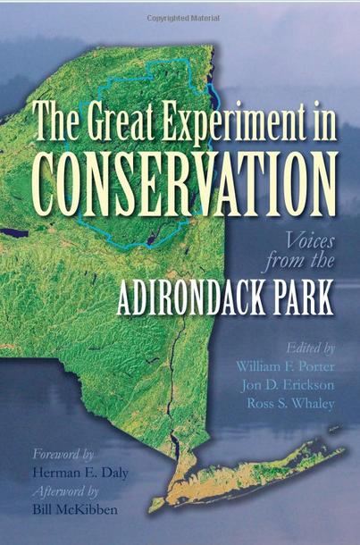
Project Summary
The main ideas for this project came to
us after reading this book
We sketched a couple of endstates
based on the book and then started
circulating them
The Common Ground Alliance agreed to sponsor the project, which kicked off at their annual forum in July 2011
  120 people were introduced to the scenarios and 90 of them said they would participate in workshops
We presented the final results at the CGA forum in July 2012

Slide 4
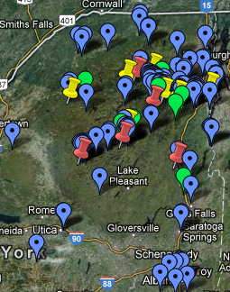
Project Summary
120 interviews
Five 2-day workshops (red) w/170 participants (blue)
8 short workshops w/214 participants (yellow)
  (NYC is not shown on the map)
Green: 9 talks (680) people)
July 18, 2012

Slide 5
Who Participated
Education had the highest participation which includes students, teachers and university level people

Slide 6
We Write Scenario Building Kits
F. ADK State Forest
120 Interviews plus various books, articles and research
E. Post Big-Gov’t
D. ADK County
C. Sustainable
Feral Pigs Go Hog Wild in the Adirondacks
B. A Usable Park
A. Wild Park
Just like in California, wild boar populations have become a serious problem all over New York. Eurasian wild boars had become popular on privates hunting estates but escaped and multiplied rapidly. They are intelligent, adaptable, eating almost anything able to live in a wide range of habitats. These are not your average Porky Pigs.
±
2020
Endstates
Events

Slide 7
Mapping the Scenarios
What does it take to get to the future you want?
Endstate C
Endstate B
Endstate A
Endstate D
Events
Build paths of events to each endstate
Find those that are
  forks in the road or
  common to many or
  unique to one
Today
State

Slide 8
How the Scenarios Fit Together over Time
Sometimes Diverging, Sometimes Converging
Activity and/or Adoption
C
A
Startup Phase
D_{product}
D_{proto}
B+C
E
New Strategy Kicks In
Original Doesn’t Pan Out
Lower level of effort on E activity
Time

Slide 9
The Endstates
2037 A: Wild Park
2037 B: A Usable Park
2037 C: The Sustainable Life
2037 D: Adirondack County
2037 E: Post “Big Government” Solutions
2037 F: Adirondack State Forest

Slide 10
F: The Adirondack State Forest 2037
External threats including climate change, invasive species and mercury deposition overwhelmed the Park from all sides.
Meanwhile, healthcare and pension costs have eaten up government budgets and buried businesses and families.
The economy of the interior the Park has imploded. Poverty has deepened. Much of it is not a pretty place to visit.
NYS demographics shift toward non-white, urban, who are just not motivated by a 19th century ideal of uplifting wilderness.
The low tax, less govt movement has cut govt spending, with reduced funding for enforcement of regulations
Government employment has been drastically cut
A constitutional amendment redefines the non-wilderness half of the Forest Preserve as a State Forest, with multiple uses, including sustainable forest harvesting. Towns share in the income but receive no taxes on the State Forest lands.
The wilderness lands remain Forest Preserve

Slide 11
What We’ve Learned about F
To most people this outcome would signal that the Great Experiment has failed
But to many, that doesn’t mean that the outcome is totally bad
This smaller core wild park surrounded by a lot of working forest surrounded by bigger settlements is a good model ecologically and economically
  It’s a lot like what Lawrence Rockefeller once proposed
We should worry about whether the next generation of New York State citizens will want to enjoy or support the Park
  Programs of marketing, outreach, education, school exchange should have high priority
We need not play victims of external threats and macro-economic swings, we can have a better future than this one

Slide 12
E: Post “Big Government” Solutions
The Park is too big and diverse for a single approach. Town and village leaders make a variety of different bets on economic development. Many succeed, but some fail.
Self-reliance, citizen initiatives, private investment and professional local government characterize successful Towns
Gaps widen between areas with better infrastructure (like broadband and health care) and the poorer towns.
Edges of the Park have grown much faster than other rural areas of NYS (e.g., Global Foundries, Ft Drum)
Other towns capitalize on recreational or educational assets
The most common theme is to leverage the Park as an asset and use balanced regulation to preserve that advantage.
Land owners and town govts spend to combat invasives and clean up septic systems to protect their land values
Bottoms-up, opportunistic initiatives with pragmatic, can-do attitudes prevail, not top-down grand solutions.

Slide 13
What We’ve Learned about E
This endstate is always less desirable than D, the consolidation one, even in AATV
Viewed as what we get if we can’t pull together more
  Sustains the fragmentation few of us like; it limits our scale and increases coordination costs
  Darwinian and competitive in an unhealthy way
Private investment and citizen engagement are hallmarks of any successful scenario
Some hamlets in the Park may fade away, NYS won’t rescue them, but that’s not the plan
Success requires a bundle of assets: health care, broadband, cell service, engaged resident and summer communities, leverage of unique local features

Slide 14
A: Wild Park 2037
Article XIV remains the foundation of the Park
Preserving the wild, open space, experience is the main mission of the APA and especially DEC, with economic and even ecosystem health secondary; it’s not about balance
A hands-off approach to the Forest Preserve, even in the face of invasives and climate change stresses
The Forest Preserve is larger and more contiguous. Private land use regulation is tighter
There has been no increase in visitors or resident population – it remains pretty much the same as 2012
Stream-side farmers, waterfront owners and road crews have voluntarily moved to better protect lakes and streams.
The Park is a major research center for impacts of climate change, acid rain and invasives.
The Park’s communities suffer the same problems as other northern forest regions, but the Park is not the cause of them.

Slide 15
What we Learned about A
Early on we tried an extreme version of A, but hardly anyone wanted to defend it, so we tamed it down, some say too tame
This endstate is slightly more favored by people who don’t live here than those who do
  But that doesn’t mean that residents don’t like the Park, or that seasonal residents don’t value the communities
Most people think this experiment IS about balance: wilderness conservation intermingled with sustainable use of private land for communities: our distinguishing feature
  Either would be hard, together they’re a challenge
  Downstream from the big mid-west polluters and a few hours drive from the biggest airports and cities in the east
A is a debate about the Forest Preserve, so it is incomplete with respect to the whole Park

Slide 16
D: Adirondack County 2037
The Blue Line has been declared a single county and major State Agencies have aligned to it, creating economies of scale and more efficient government throughout the Park.
  Driven by outrage at the obvious overlap, fragmentation and duplication of so much government for so few people
Resulted in Park-wide identity and a voice that can be heard in Albany. Less competition town vs. town and more cooperation.
Privatization of recreational facilities and services like road maintenance and health care, shifting jobs into private sector.
School system consolidation allows specialization and sharing
Smarter government that uses information technology better and puts more emphasis on integrated planning.
Standardization and simplification of processes make things easier for businesses and citizens.
The Forest Preserve has been consolidated and rationalized through numerous land swaps.

Slide 17
What We’ve Learned about D
Every meeting ranked this more desirable than E, our fragmented approach to government
  Surprising enthusiasm for more centralized government services
Classic example of a desirable outcome that is considered impossible to achieve
Aside from the county idea, much of the endstate is considered attainable over 25 years
  The tax cap will force towns, schools and counties to find ways to do things more efficiently
  Computer and network improvements will make some centralization easier
Forest Preserve consolidation through land swaps gets strong support across the board
Planning for the Forest Preserve and private land in larger blocks (complexes) is a good next step; easement lands should be included
Outsourcing government assets as a strategy for improving efficiency has mixed support

Slide 18
B: A Usable Park 2037
Recreational tourism and meeting the needs of baby boom retirees are the two big engines of economic growth
The Park is a world-class destination attracting nearby and international travelers
The wild areas of the Park have become more wild and the already developed areas, in and near hamlets, more developed
An integrated recreation plan spreads out different users across 4 seasons and the entire Park. More Indoor attractions.
There has been a major increase in visitor services that people pay for, creating income for residents
ADK-branded recreational equipment manufacturing
Active retiring boomers move into their vacation homes in areas with best access to health care, internet, cell phones, arts and other amenities. New CCRs in the Park.
Government employment has dropped considerably but the private sector more than filled the gap.

Slide 19
What We’ve Learned about B
This endstate speaks to the unique advantages of the region
It’s what we are doing already, only we will be doing it better
There is hope (and some evidence) that we can benefit from working regionally, in a more integrated and cooperative manner
  Partnerships including DEC, local gov’t, NGOs, and citizen groups
Tourism builds support for the Park’s future in a new generation and new, more diverse visitor segments
  Upgrading our visitor offerings is essential: places to stay, eat, shop
The active retired can be great assets to communities
  Health care and services for the aging are not where they need to be
The impact of climate change on our outdoor winter sports economy is a real issue that needs a strategy
Sustainable tourism means limiting use of the Forest Preserve
  Don’t degrade the experience for the next person, or next generation

Slide 20
C: The Sustainable Life 2037
People of all ages move here as a quality of life decision, attracted to the hamlet life, small schools, the arts scene and a shared set of community and environmental values
Widespread broadband enables new jobs
Biomass heating systems are widespread, especially for large buildings, keeping energy dollars in the region.
Many renewable energy sources: community solar farms, retrofitted old dams, home-scale wind, and private solar
The local food industry has scaled up and regional coops are in place for meat processing, marketing and distribution.
Land use regs encourage clustering in hamlets and permit community-scale renewable energy solutions.
Science based management of the forest, even the Forest Preserve, helps it to adapt to climate change and invasive species threats

Slide 21
What We’ve Learned about C
Has wide support and particularly appeals to young people
C responds to climate change, aligning us with the State’s goal to make renewable energy 30% of the State’s energy supply by 2015
Localization of the energy and food sectors adds local jobs w/o growing the whole economy much
It links to the old self-reliant culture and traditional sectors such as agriculture, forest products and guiding, caretaking
  But updated to be more sustainable and diverse
But it is also welcoming of new people and technology
  Net-based jobs, knowledge economy entrepreneurs
  The Capitol region is becoming a major new high-tech center and the Park can ride its coat tails
A diverse economy, primarily based on smaller businesses, that tries to avoid a few large employers

Slide 22
Rank The Endstates
Rank order endstates A thru F from most desirable(= position 1) to least(=6)
Rank order endstates A thru F from most attainable (= position 1) to least(=6)
 | Desirability
1
2
3
4
5
6
 | Attainability
1
2
3
4
5
6
Most
Most
Least
Least
Use each endstate letter once in one of the six boxes in the column
Fill in every box with a letter; start with the one you find most desirable, then the least and then fill in the middle; repeat for attainability
Do this now, individually, and give it to us before the break

Slide 23
EXAMPLE
Most
Most
 | Desirability
1 | A
2 | B
3 | C
4 | D
5 | E
6 | F
 | Attainable
1 | F
2 | E
3 | D
4 | C
5 | B
6 | A
Least
Least
No ties, no endstates should be left out

Slide 24
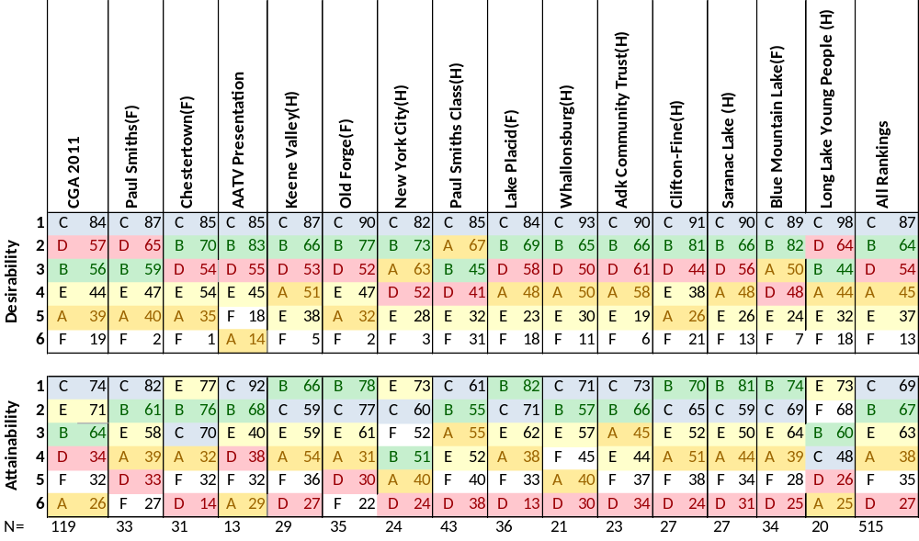
All Workshops Ranking Results

Slide 25
Getting From Here to There
The events selected most often in the workshops provide a good outline of a plan
Additional work was done at the CGA Forum on July 18 to develop next steps on:
  Local Food
  Shared Transportation
  Attracting Retirees
  Small Business Generation
  Branding and Promotion
  Government Services Consolidation
  Water Quality Protection
  Constitutional Amendments
  Education

Slide 26
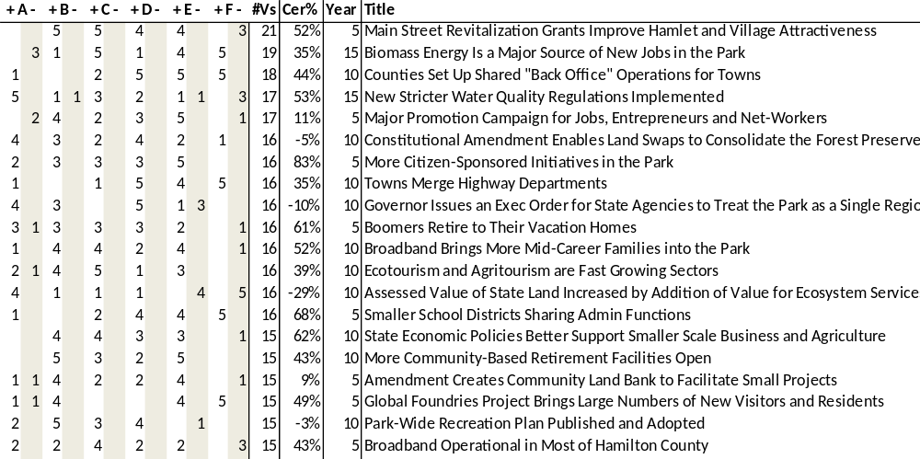
Positive Common Events
Economic Development
Retirees
Government
Regulation
Tourism
The events selected regularly in the scenarios: steps on the way to a better future

Slide 27
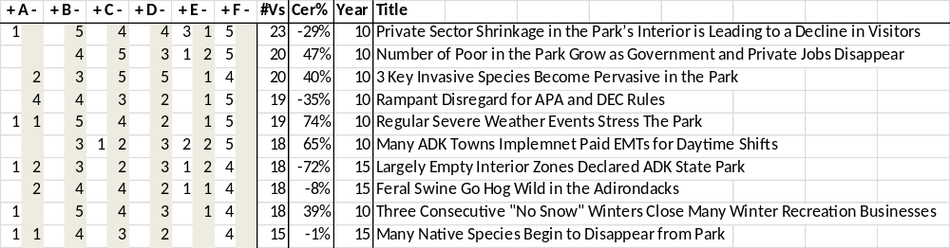
Negative Common Events
Environmental Stress
Poverty
The events that we don’t want to have happen and that lead to the negative scenarios of E and F
In some cases, we think they are going to happen to us (e.g., more severe weather) and we need to prepare better for them

Slide 28
Mixed Common Events
These events are more mixed in how scenario teams reacted and there is no consensus on them

Slide 29
Emerging Strategy
C+B: the core future of the Park. Done properly, they are not in conflict; they are doable and underway
  These share many features: broadband, health care, transportation, etc
  These work both locally and regionally
  Either C or B alone seems too fragile a bet on the future
A: The Forest Preserve is the region’s foundation
  Regulatory tweaks for the FP (e.g. Utility Land Bank, SLMP review)
  Time to consider a program of land swaps to make it more contiguous
  Science based forest management, not completely hands-off
D: Many see value in a more coherent sense of a Park
  Trust = Consolidation = Much less government
  A special region, with special needs, seeking a stronger identity
  State funding is more likely on a regional level so look for projects that span community boundaries like watersheds, wilderness recreation complexes, health care regions
  Incremental change, not a big jolt like a county or a Park Service

Slide 30
Emerging Strategy -2
E: Local initiatives are what works
  Effective leaders and engaged citizens are great features
    Squeaky wheels get more attention, it’s true
  Hamlets with weak services will slowly lose population and fade quietly
  We can do better than this scenario of fragmentation
    We have shown it with the large number of regional efforts underway

Slide 31
Endstate Implementation Over Time
C: will have ups and downs due to need for behavior changes
100%
C
B: starts high, improves, then tapers off
B
A: Forest Preserve is
Solid
A
D
E: slow fade as we
act more regionally
D: will grow slowly early,
then take hold
E
0%
Today
TIME
2037

Slide 32
Viewed by Land Type
Private Land
Easement Land
Forest Preserve
Eco-, Agro- and Heritage Tourism
Back Country
Wild Experience
A
Sustainable Recreational Tourism
C
B
Sustainable
Local Energy & Local Food
Front Country
Ubiquitous
Broadband
Vibrant Communities with
Good Small Schools
Healthcare

Slide 33
Even Simpler
C
C: healthy communities and
a commitment to more sustainable lifestyle; sustainability principles
put limits on the
growth fostered by B
B: draw more visitors,
retirees and families
to our Park to enjoy our
wild lands, open landscape
and diverse communities
A: protect and enhance the Forest Preserve, our core resource and accomplishment
B
A

Slide 34
Viewed as
Victims of External Events
DBcA
Governor Orders Agencies to Align?
Y
N
BcA
Y
CBA
Y
N
Today
N
Y
EA
N
Fracking Approved in NYS?
F
Good Economic Recovery?
NYS Voter Support for FP Strong?

Slide 35
The Vision Slides

Slide 36
A Vision of Healthy Communities and Ecosystems in Balance
Understanding of the interdependence of our economy and our environment takes hold
The mixture of public and private land is our defining feature; it drives our diverse sustainable economy and increases our self-reliance
Balanced, slightly more flexible, regulation preserves this unique landscape, while enhancing the overall health of our communities

Slide 37
A Diverse, Local, Sustainable Economy
Localize current spending within the Park by buying local food, energy, forest products, etc.
  Reinforce the self-reliance that has traditionally been part of this region’s character
  Lower our use of fossil fuels and send less of our wealth outside the Park
  Biomass and solar energy are a key part of this strategy
Bring more dollars into the economy by expanding tourism
  Grow eco-, agro- and heritage tourism
  Diverse recreation activities, services and equipment for a much more diverse set of visitors
    More international, more non-white
  More “product” for visitors’ spending
  An integrated public/private recreation plan stitches together the whole Park experience

Slide 38
A Diverse Local Economy – Cont.
Build out broadband infrastructure to allow some people to work at jobs outside the Park, but live in our communities
  Teleworkers and knowledge economy entrepreneurs
  Leverage the region’s colleges and the Albany region’s high tech boom
Use the forest and the land sustainably, avoiding over-harvesting or overuse for recreation
Leverage unique historical, cultural and natural features to maintain the unique character and appeal of each area

Slide 39
Stronger, Open, Communities
We host more visitors who want to play in, and learn from, our protected landscapes
  People who move here are usually visitors first
  Hamlets that are more dynamic and welcoming of new comers succeed
The hamlets are as big a draw as the Forest Preserve
  Trails interconnect hamlets for hikers, bikers, snowmobilers, etc.
  Living in the hamlets is cool again: walking, biking, knowing your neighbors
Vibrant visual and performing arts scene networked across the Park
  Attracts people to a community, is often the basis for revitalization and/or can be an economic driver/attraction
Upgraded infrastructure: healthcare, broadband, water treatment
Small, networked, high quality schools give students a strong understanding of this unique place
Citizens are an engaged mix of full-time and part-time residents
We attract young families and active retirees to settle here
  Our regional commitment to sustainability is a draw,
  as is the Forest Preserve

Slide 40
More Efficient, Rational, Government
Strikes the right balance between centralization for efficiency and local responsiveness
Works together across levels and functions
  Towns share services or facilities where it makes sense, collaboration rather than competition town vs. town is more widespread
Partners well with community groups and NGOs
Uses modern technology well to overcome the large distances in the Park and be more data-centric
Smart downsizing through increased collaboration, sharing of functions and elimination of overlap will proceed at all levels, forced by limits on tax revenues
State regional agency structures are rationalized to reduce coordination costs

Slide 41
Protect, Improve, the Forest Preserve
We maintain strong protections for the Forest Preserve and private land
  Regulation encourages clustering using mechanisms like Transferrable Development Rights
  State and environmental NGOs purchase additional easements keeping land productive and preserving open space
We manage the Forest Preserve using science-based stewardship and protect it against the threats of climate change and invasives
We address unintended constitutional limitations to help our communities
  Utility land bank (e.g. under roadways), FP consolidation amendments
We renew the State Land Master Plan
  Use front-country and back-country concepts, planning for large wilderness complexes instead of small UMPs
  Take easement lands into consideration
Community groups, NGOs and lake owner associations and the State collaborate to protect water quality

Slide 42
Big Themes
Alignment: what we want is what we think we can do and, wow, what a nice position to start from!
Citizen and private enterprise initiative is key
  Evidenced by the momentum we are seeing
  Public movement brings government along; government does not have to lead but it sure can help
Trust is slowly being built, and that can enable unfreezing the status quo
  For example, a SLMP update could happen

Slide 43
There is Activity Already Underway
NCREDC Council success means preferential access to funding . This plan is 100% aligned with NCREDC
  NCREDC depends upon local initiatives – nothing happens without your proposals
Broadband: The DANC trunk and ACTION telemed network are within months of completion. Planning work and funding streams are coming together for more projects.
Movement on a Park-Wide public/private recreation plan: proposal to build a Park-wide recreation web portal, the idea of planning “complexes” like the Oswegatchie
Home Grown Sustainability Plan: Ongoing effort will result in number of renewable energy project proposals for funding in the 2013-14 cycle
Several schools are integrating the ADK Futures content into existing programs

Slide 44
More Work Is Getting Organized
The CGA water quality workgroup plans to meet again
The CGA constitutional work group plans to meet again
The CGA local food group wants to meet again
The CGA promotion and branding group wants to meet again
A one day workshop with 3 towns in Hamilton County to discuss government services
Meeting about an ADK private investment fund
Publicity: an article for ADK Journal of Environmental Studies. John Sheehan has volunteered to work with us to get articles in key publications like the NY Times, ADK Life, ADK Explorer, etc.

Slide 45
Proposals at the Moment
ADK Summit meetings of a variety of key topics: Healthcare, Science in the Park, Art in the Park, Education, and so on
A number of NGOS and other groups are interested in having us present the findings and help them align relevant parts of the plan
  ADK Land Owners Association
  ADK Community Trust
  Protect the ADKs
  We have yet to talk with ADK Museum, WCS, TNC, ANCA, ADK Partnership
Presentations to and dialogue with local government groups including: Essex County Board, LGRB, AATV
Presentation to ADK Working Group of 3 REDCs that include parts of the Park
One or two briefings in Albany to Park legislators, senior staff from various agencies and the Governor’s office
NY State Museum in Albany may include a tracking display of the scenarios as part of a renovation of the ADK displays
Jon Erickson is seeking additional funding for his documentary on CGA

Slide 46
Feedback
How well aligned is this strategy with the goals and objectives of the APA?
How great an impact would this strategy have on the APA?
How great an impact can the APA have on this strategy?
Where? In what areas?
What organizations can the APA work with to implement parts of this strategy?

Slide 47
Thank You
Use the website: www.ADKfutures.org to stay connected to this effort
  dave12942@gmail.com
  jim12942@gmail.com

