Slide 1

Mapping the Future of the Adirondack Park
Project Final Report
Common Ground Alliance Forum
July 18, 2012, Long Lake, NY
Dave Mason & Jim Herman

Slide 2
Project Results
A year ago we set out to improve the conversation about the Park using a scenario planning process
  It feels like we did that
Over 500 people have participated in our workshops and then brought the ideas to their friends and colleagues
With their time, effort and creativity a strategy for the Park is emerging and there is a lot of forward momentum
As side benefits, we have
  A common language for discussing complex issues
  A map of events to use to monitor what actually happens and course correct when necessary
  More trust among many of us that we really do have common ground, even while we sometimes disagree on the details

Slide 3
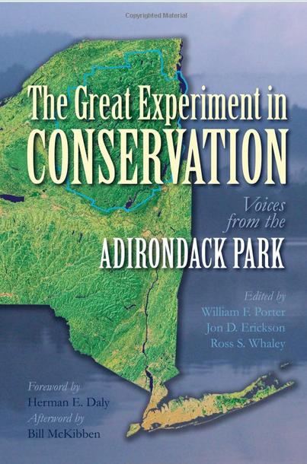
A Note About the Cameras
What we are doing here in the Adirondacks may be relevant to other rural communities
We are exploring how to put the
issues, and our approach to the conversation, into video form
Jon Erickson, co-editor of The Great
Experiment in Conservation, has a
grant to produce a PBS special on
how we are finding Common Ground

Slide 4
Outline
Project Overview
What We’ve Learned in a Year
Emerging Strategy
Keeping the Momentum Going

Slide 5
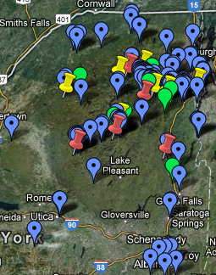
Project Summary
120 interviews
Five 2-day workshops (red) w/170 participants (blue)
8 short workshops w/214 participants (yellow)
  (NYC is not shown on the map)
Green: 9 talks (470) people)
July 18, 2012

Slide 6
Businesses, Comm Dev, Arts, NGOs
General Business
Adirondack Broadband
Champlain Bank
Community Bank
Elan Planning, Design and Development
Fuller Communications
General Composites
Geomatics Land Surveying
North Country Chamber of Commerce
Placid Time Photography
Wild Orchard Farm
Venture Capital (2)
Self-Employed Artist, Author, Guide, Contractor, CPA, Logger, Psychologist
Tourism
Lake Placid Crown Plaza and Resort
Lake Placid Pub and Brewery
Leveille Development and Planning / Lake Placid Lacrosse
Minnowbrook Conf Center
Regional Office of Sustainable Tourism
The Wild Center
Publishing
Adirondack Almanack
Adirondack Explorer
Mountain Lakes PBS
Arts
Adirondack Lakes Center for the Arts
Bolton Gallery and Art Center
Ctl ADKs Arts & Science Advocacy
Headlamp Pictures
Tahawus Lodge
View Arts Center
Community Development
Adirondack Community Trust
Adirondack North Country Assoc.
Adirondack Sustainable Communities
Ausable Watershed Exploratory Committee
CAP-21
Community Foundation of Herkimer and Oneida Counties
Episcopal Church of Saranac Lake
Niccolls Church
Keene Valley Congregational Church
North Elba / Lake Placid Community Development Board
Sustainable Living Project
Upstate Adirondack Dev. Corp
Park-Wide NGOs
Adirondack Council
Adirondack Landowners Association
Adirondack Wild
ADK Action
Northern Forest Center
Protect the Adirondacks
The Nature Conservancy / Adirondack Land Trust
Wildlife Conservation Society
Tourism
Adirondack Museum
Adirondack Architectural Heritage
Adirondack Fire Tower Association
Adirondack Mountain Club
Ausable Club
Blue Mountain Center
Great Camp Sagamore
Golden Arrow Lake Resort

Slide 7
Education, Health Cr, Government
Higher Education
Clarkson University
Colgate University
Cornell University
North Country Community College
Paul Smiths College
SUNY ESF Wanakena Ranger School
SUNY ESF Northern Forest Institute
SUNY ESF ADK Ecological Center
St Lawrence University
Workforce Development Institute
Town and Village Government
Adirondack Association of Towns and Villages
APA Local Government Review Board
Blue Mountain Lake EMT
High Peaks Education Foundation
Keene Board of Education
Keene Central School District
Ticonderoga Revitalization Alliance
Ticonderoga Central School District
Town of Belmont
Town of Essex
Town of Fine
Town of Morehouse
Town of Wells
Town of Webb
North Elba / Lake Placid Community Development Board
County Government
Hamilton County Chairperson
Hamilton County League of Women Voters
Essex County Planner
Essex County IDA
Essex County Public Health
Adirondack Community Housing Trust
State Government
Deputy Sec of State for Local Government
Adirondack Park Agency
NYS Department of Transportation
NYS Department of Environmental Conservation
NYS State Senator Betty Little
NYS Tug Hill Commission
North Country Regional Economic Development Council
Health Care
Adirondack Health
Creative Healing Connections
Hudson Headwaters Health Network
Peaks and Valleys Counseling
CVPH

Slide 8
Two Day Attendees
Blue Mtn Lake, 34

Slide 9
Half-Day Attendees
Lake Placid, 23
Clifton Fine, 29
Saranac Lake, 27

Slide 10
Profile of Two Day Attendees
Blue Mtn Lake, 34

Slide 11
Profile of Half-Day Attendees
Lake Placid, 23
Saranac Lake, 27
Clifton Fine, 29

Slide 12
We Write Scenario Building Kits
F. ADK State Forest
E. Post Big-Gov’t
D. ADK County
C. Sustainable
Feral Pigs Go Hog Wild in the Adirondacks
B. A Usable Park
A. Wild Park
Just like in California, wild boar populations have become a serious problem all over New York. Eurasian wild boars had become popular on privates hunting estates but escaped and multiplied rapidly. They are intelligent, adaptable, eating almost anything able to live in a wide range of habitats. These are not your average Porky Pigs.
±
2020
Endstates
Events

Slide 13
Mapping the Scenarios
What does it take to get to the future you want?
Endstate C
Endstate B
Endstate A
Endstate D
Events
Build paths of events to each endstate
Find those that are
  forks in the road or
  common to many or
  unique to one
Today
State

Slide 14
The Endstates, 2037
A: Wild Park
B: A Usable Park
C: The Sustainable Life
D: Adirondack County
E: Post “Big Government” Solutions
F: Adirondack State Forest

Slide 15
What We’ve Learned about
F: Adirondack State Forest
To most people this outcome would signal that the Great Experiment has failed
But to many, that doesn’t mean that the outcome is totally bad
This smaller core wild park surrounded by a lot of working forest surrounded by bigger settlements is a good model ecologically and economically
  It’s a lot like what Lawrence Rockefeller once proposed
We should worry about whether the next generation of New York State citizens will want to enjoy or support the Park
  Programs of marketing, outreach, education, school exchange should have high priority
We need not play victims of external threats and macro-economic swings, we can have a better future than this one

Slide 16
What We’ve Learned about
E: Post Big-Government Solutions
This endstate is always less desirable than D, the consolidation one
Viewed as what we get if we can’t pull together more
  Sustains the fragmentation few of us like; it limits our scale and increases coordination costs
  Darwinian and competitive in an unhealthy way
Private investment and citizen engagement are hallmarks of any successful scenario
Some hamlets in the Park may fade away, NYS won’t rescue them, but that’s not the plan
Success requires a bundle of assets: health care, broadband, cell service, engaged resident and summer communities, leverage of unique local features

Slide 17
What We’ve Learned about
A: Wild Park
The version we presented here last year felt too extreme, hardly anyone wanted to go that far, so we tamed it down a bit, some say too tame
The current version is slightly more favored by people who don’t live here than those who do
  But that doesn’t mean that residents don’t like the Park, or that seasonal residents don’t value the communities
A is a debate about the Forest Preserve, so it is incomplete with respect to the whole Park
Most people think this experiment IS about balance: wilderness conservation intermingled with sustainable use of private land for human communities
  Either would be hard, together they’re a challenge
  Downstream from the big mid-west polluters and a few hours drive from the biggest airports and population centers

Slide 18
What is Wild?
What is “Wild” really all about?
  Hands-off? But the hand of man is in every drop of rain and air molecule in the Park. Not hands off in a fire or, it would seem, or a serious invasive attacks
  Maintaining a museum Park with antique style structures tied to classic brand image?
  If it is about the experience of solitude, etc., then we have to limit usage
  If it means keeping people away altogether, then it has to be limited to a portion of the Forest Preserve
Our actions say we want to:
  Recreate in vast tracts of open space with sparse settlement
  Protect our water and forest from infestation, pollution and over use
  Put value on the unique resource we have created in the Forest Preserve (large scale is part of its uniqueness)
  Use science to make decisions about how to protect and conserve
Consider re-thinking the edges where wild meets inhabited areas
Consider putting more emphasis on “forever”, i.e. protection against man-made threats rather than leaving all to natural processes
Protecting the forest will surely be the main mission of this century

Slide 19
What We’ve Learned about
D: Adirondack County
Every meeting ranked this more desirable than E, our fragmented approach to government
  Not long ago, few would have dared champion such a centralized scheme for government, so this is a major shift in local opinion
Classic example of a desirable outcome that is considered impossible to achieve
Aside from the county idea, much of the endstate is considered attainable over 25 years
  The tax cap will force towns, schools and counties to find ways to do things more efficiently
  Computer and network improvements will make some centralization easier
Forest Preserve consolidation through land swaps gets strong support across the board
Planning for the Forest Preserve and private land in larger blocks (complexes) is a good next step; easement lands should be included
Outsourcing government assets as a strategy for improving efficiency has mixed support

Slide 20
What We’ve Learned about
B: A Usable Park
This endstate speaks to the unique advantages of the region
It’s what we are doing already, only we will be doing it better
There is hope (and some evidence) that we really can benefit from working regionally, in a more integrated and cooperative manner
  Partnerships including DEC, local government, NGOs, and citizen groups are the model
  The recreation plan’s group is an example
Tourism builds support for the Park’s future in a new generation and new, more diverse visitor segments
Upgrading our visitor offerings is essential: places to stay, eat, shop, etc.
The active retired can be great assets to communities
  Health care and services for the aging are not where they need to be – they could be an opportunity
The impact of climate change on our outdoor winter sports economy is a real issue that needs a strategy
Sustainability means limiting use of the Forest Preserve
  Don’t degrade the experience for the next person, or the next generation

Slide 21
What We’ve Learned about
C: The Sustainable Life
Has wide support and particularly appeals to young people
This endstate responds to climate change, aligning us with the State’s goal to make distributed, renewable energy 30% of the State’s energy supply by 2015
It links to the old self-reliant culture and traditional sectors such as agriculture, forest products and guiding
  But updated to be more sustainable and diverse
But it is also welcoming of new people and technology
  Net-based jobs, knowledge economy entrepreneurs
  The Capitol region is becoming a major new high-tech center and the Park can ride its coat tails
A diverse economy, primarily based on smaller businesses, that tries to avoid a few large employers

Slide 22
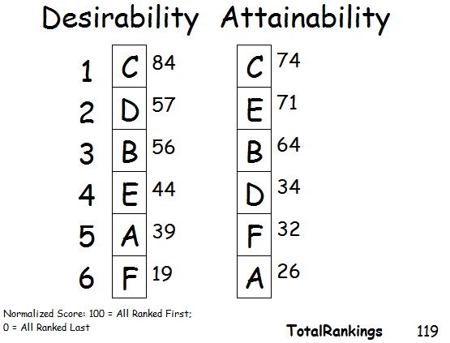
Ranking Results
Remember this from last year (July 20, 2011):

Slide 23
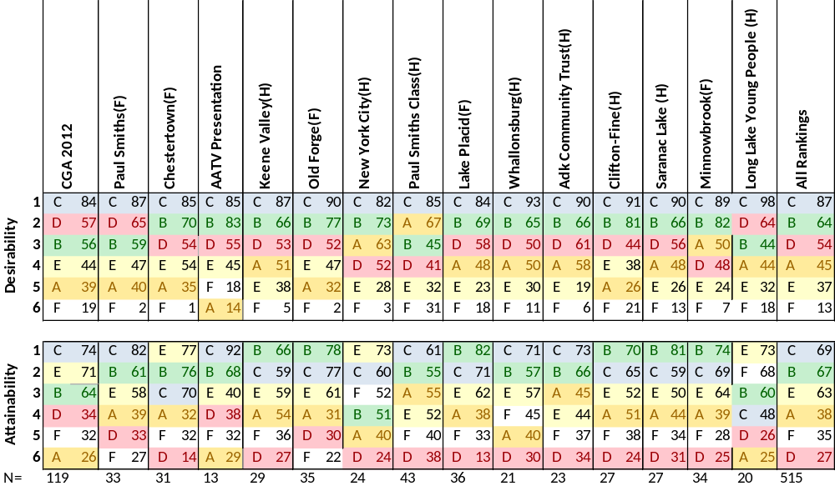
All Workshops Ranking Results

Slide 24
Endstate Implementation Over Time
C: will have ups and downs due to need for behavior changes
100%
C
B: starts high, improves, then tapers off
B
A: Forest Preserve is
Solid
A
D
E: slow fade as we
act more regionally
D: will grow slowly early,
then take hold
E
0%
Today
TIME
2037

Slide 25
Viewed by Land Type
Private Land
Easement Land
Forest Preserve
Eco-, Agro- and Heritage Tourism
Back Country
Wild Experience
A
Sustainable Recreational Tourism
C
B
Sustainable
Local Energy & Local Food
Front Country
Ubiquitous
Broadband
Vibrant Communities with
Good Small Schools
Healthcare

Slide 26
Viewed as
Victims of External Events
DBcA
Governor Orders Agencies to Align?
Y
N
BcA
Y
CBA
Y
N
Today
N
Y
EA
N
Fracking Approved in NYS?
F
Good Economic Recovery?
NYS Voter Support for FP Strong?

Slide 27
Emerging Strategy
C+B: the core future of the Park. Done properly, they are not in conflict; they are doable and underway
  These share many features: broadband, health care, transportation, etc
  These work both locally and regionally
  Either C or B alone seems too fragile a bet on the future
A: The Forest Preserve is the region’s foundation
  Regulatory tweaks for the FP (e.g. Utility Land Bank, SLMP review)
  Time to consider a program of land swaps to make it more contiguous
  Science based forest management, not completely hands-off
D: Many see value in a more coherent sense of a Park
  Trust = Consolidation = Much less government
  A special region, with special needs, seeking a stronger identity
  State funding is more likely on a regional level so look for projects that span community boundaries like watersheds, wilderness recreation complexes, health care regions
  Incremental change, not a big jolt like a county or a Park Service

Slide 28
Emerging Strategy -2
E: Local initiatives are what works
  Effective leaders and engaged citizens are great features
    Squeaky wheels get more attention, it’s true
  Hamlets with weak services will slowly lose population and fade quietly
  We can do better than this scenario of fragmentation
    We have shown it with the large number of regional efforts underway
F: Reminds us of the cost of failure
  As written, F is a way to handle a severe decline in population and visitors
  Of course there are other big external events we might have to handle

Slide 29
A Vision of Healthy Communities and Ecosystems in Balance
Understanding of the interdependence of our economy and our environment takes hold
The mixture of public and private land is our defining feature; it drives our diverse sustainable economy and increases our self-reliance
Balanced, slightly more flexible, regulation preserves this unique landscape, while enhancing the overall health of our communities

Slide 30
The Diverse, Local Sustainable Economy
Localize current spending within the Park by buying local food, energy, forest products, etc.
  Reinforce the self-reliance that has traditionally been part of this region’s character
  Lower our use of fossil fuels and send less of our wealth outside the Park
  Biomass and solar energy are a key part of this strategy
Bring more dollars into the economy by expanding tourism
  Grow eco-, agro- and heritage tourism
  Diverse recreation activities, services and equipment for a much more diverse set of visitors
    More international, more non-white
  More “product” for visitors’ spending
  An integrated public/private recreation plan stitches together the whole Park experience

Slide 31
The Diverse Local Economy – Cont.
Build out broadband infrastructure to allow some people to work at jobs outside the Park, but live in our communities
  Teleworkers and knowledge economy entrepreneurs
  Leverage the region’s colleges and the Albany region’s high tech boom
Use the forest and the land sustainably, avoiding over-harvesting or overuse for recreation
Leverage unique historical, cultural and natural features to maintain the unique character and appeal of each area

Slide 32
Stronger, Open, Communities
We host more visitors who want to play in, and learn from, our protected landscapes
  People who move here are usually visitors first
  Hamlets that are more dynamic and welcoming of new comers succeed
The hamlet communities are as big a draw as the Forest Preserve
  Trails interconnect hamlets for hikers, bikers, snowmobilers, etc.
  Living in the hamlets is cool again: walking, biking, knowing your neighbors
Vibrant visual and performing arts scene networked across the Park
  Attracts people to a community, is often the basis for revitalization and/or can be an economic driver/attraction
Upgraded infrastructure: healthcare, broadband, water treatment
Small, networked, high quality schools give students a strong understanding of this unique place
Citizens are an engaged mix of full-time and part-time residents
We attract young families and active retirees to settle here
  Our regional commitment to sustainability is a draw,
  as is the Forest Preserve

Slide 33
More Efficient, Rational Government
Strikes the right balance between centralization for efficiency and local responsiveness
Works together across levels and functions
  Towns share services or facilities where it makes sense, collaboration rather than competition town vs. town is more widespread
Partners well with community groups and NGOs
Uses modern technology well to overcome the large distances in the Park and be more data-centric
Smart downsizing through increased collaboration, sharing of functions and elimination of overlap will proceed at all levels, forced by limits on tax revenues
State regional agency structures are rationalized to reduce coordination costs

Slide 34
Protect, Improve, the Forest Preserve
We maintain strong protections for the Forest Preserve and private land
  Regulation encourages clustering using mechanisms like Transferrable Development Rights
  State and environmental NGOs purchase additional easements keeping land productive and preserving open space
We manage the Forest Preserve using science-based stewardship and protect it against the threats of climate change and invasives
We address unintended constitutional limitations to help our communities
  Utility land bank (e.g. under roadways), FP consolidation amendments
We renew the State Land Master Plan
  Use front-country and back-country concepts, planning for larger wilderness complexes instead of small UMPs
  Take easement lands into consideration
Community groups, NGOs and lake owner associations and the State collaborate to protect water quality

Slide 35
Big Themes
Alignment: what we want is what we think we can do and, wow, what a nice position to start from!
Citizen and private enterprise initiative is key
  Evidenced by the momentum we are seeing
  Public movement brings government along; government does not have to lead but it sure can help
Trust is slowly being built, and that can enable unfreezing the status quo
  For example, a SLMP update could happen

Slide 36
Information Technology
This used to be our specialty
Now that we are making progress on broadband installation, the next focus should be on integrated information bases
  GIS, permitting, etc.
  Real-time conditions for area visitor attractions
Video calling (e.g., Skype)and webcams can help overcome the problems of our large geographic spread

Slide 37
Getting From Here to There
The selection of events in the workshops provides a good outline of a plan
In a number of areas, work has already begun and we’ll hear about them this afternoon:
  Broadband
  Integrated Recreation Plan
  Home Grown Sustainability Plan
  Adirondack Partnership
  North Country Regional Economic Development Council
In 8 other areas, we will ask you to do a little work over the next hour

Slide 38
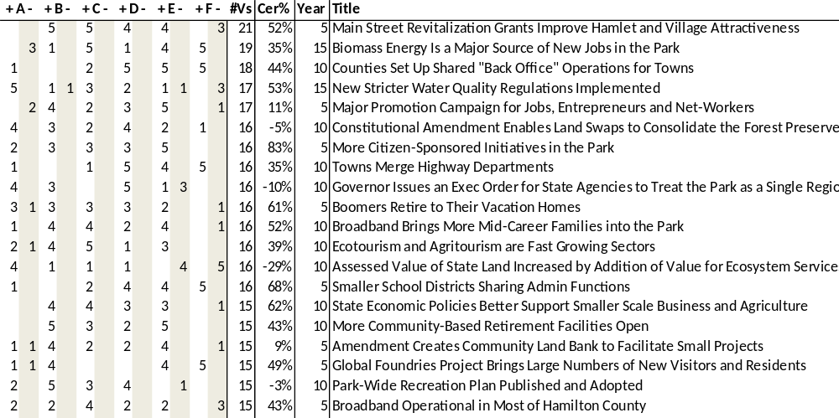
Positive Common Events
Economic Development
Retirees
Government
Regulation
Tourism
The events selected regularly in the scenarios: steps on the way to a better future

Slide 39
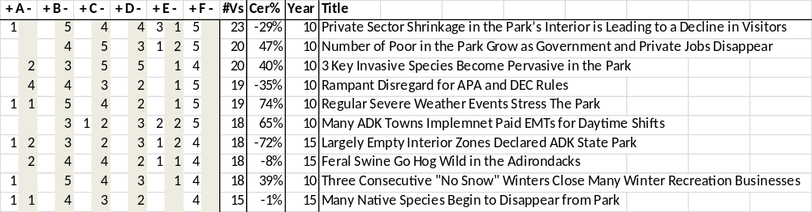
Negative Common Events
Environmental Stress
Poverty
The events that we don’t want to have happen and that lead to the negative scenarios of E and F
In some cases, we think they are going to happen to us (e.g., more severe weather) and we need to prepare better for them

Slide 40
Mixed Common Events
These events are more mixed in how scenario teams reacted and there is no consensus on them

Slide 41
Fill Out Your Card
We want your feedback on our conclusions and proposed strategy
  Fill out the top part of the card
We also want you to help us figure out how to keep the momentum going
  You can go to a predetermined focus area workgroup or
  Make up your own topic and network to find people also interested that topic
Take 5 minutes and fill out both parts of your card as best you can

Slide 42
Eight Topics to Pick From
Small business generation
Attracting retirees
Government services consolidation
Water quality
Promotion and branding
Constitutional amendments
Shared transportation
Local Food
Or
Make up your own topic area (e.g., great small schools, storm water treatment, health care delivery, etc.)
  Write on the sticky name tag and label yourself!
  Fill out the card for your topic

Slide 43
Workgroup Task
Move to the topic area you are interested in working on (vote with your feet)
  Those networking and interested in an ad hoc topic move outside the pavilion
Assemble into groups of no more than 12. Split into more small groups as needed.
  If you find a few others interested in your ad hoc topic compare your card notes, have a discussion, add to your cards
Discuss the proposed vision for the next 25 years (10 minutes)
  Additions?, Deletions?, Controversies?
Answer the following questions on cards provided: (45 minutes)
  Are there parts of the Park that are currently making progress on this issue?
  How can we make more general progress?
  Who (agency, NGO, private investors, etc.) can work on this?
  What are the next three steps you recommend?
Please give your card to one of the facilitators or interns
  We want your feedback, the cards are, in effect, our notes

Slide 44
Small Business Generation
Much of the economic development we need is in small businesses
What does “Open for Business” mean for small business?

Slide 45
Attracting Retirees
Attracting the active retired to live in the Adirondacks is a key part of Scenario B
They bring money, ideas, energy and a love for this place
Many can live in their (modified) vacation homes

Slide 46
Government Services Consolidation
Everyone expects the tax cap will force various consolidations and centralization of services
Shall we plan for it or stumble into it?

Slide 47
Water Quality
The value of Adirondack water quality is becoming ever more apparent
Strong desire to protect water quality and high expectations of more efforts in this area

Slide 48
Promotion and Branding
How do we reach new segments of the visitor population? How do we attract diverse people to move here?
Do we tell the world that the Adirondack Park is “Open For (new) Business”?

Slide 49
Constitutional Amendments
Can we dare to propose something strategic?
  Suppose we could bury things like sewer lines, fiber cables, etc. under existing pavement that happens to go through Forest Preserve?
  Suppose we could reorganize the Forest Preserve to consolidate it into larger tracts?

Slide 50
Shared Transportation
How to reduce fossil fuel use for transportation?
New vehicles or shared vehicles?
Local version of UPS for our communities as a new business opportunity in the region?
Do we need an Adirondack Transit Authority?
  County bus systems have to stop at county lines

Slide 51
Local Food
Everyone is supportive of the local food movement and there are high expectations of growth
What do we need to kick this up a notch?

Slide 52
What We Are Doing
This video, other talks and articles will get the ideas into wider circulation
  Look to our website: www.ADKfutures.org
  for a vision paper and an implementation priorities paper
  This presentation and the results handout are available now for download from the website
We’ve joined two boards:
  Adirondack Community Trust (Dave)
  Adirondack Health Foundation (Jim)
We will make ourselves available to groups who want to think about how to align to this strategy
We will monitor against this framework and report back again next year

Slide 53
Thank You
So many people have responded with energy and enthusiasm for this project
It got its start because Ross Whaley took the idea to the CGA Core Team
  What a great team to work with
Paul Smiths, Town of Chester, View, the Keene Central School, the Whallonsburg Grange, ORDA, ESF Wanakena, Harrietstown and Long Lake Central School have donated space
Thank you to the Town of Long Lake for hosting CGA so well
Melissa Eisinger, Betsey Thomas-Train, John Kelly and Kathy Hornbach
ACT, AATV and others have donated support for food
It has been tremendously rewarding

Slide 54
Eight Topics to Pick From
Small business generation
Attracting retirees
Government services consolidation
Water quality
Promotion and branding
Constitutional amendments
Shared transportation
Local Food
Or
Make up your own topic area (e.g., great small schools, storm water treatment, health care delivery, etc.)
  Write on the sticky name tag and label yourself!
  Fill out the card for your topic area

