Slide 1
ADK Futures Update
“The first step to better times is to imagine them”
a Chinese fortune cookie
Then what happens?
Adirondack Research Consortium
Lake Placid, May 2014
Dave Mason and Jim Herman

Slide 2
Mapping the Scenarios
What does it take to get to the future you want?
Endstate C
Endstate B
Endstate A
Endstate D
Events
Now tracking news about these events
Build paths of events to each endstate
The most interesting events are:
  forks in the road or
  common to many or
  unique to one
2011-12

Slide 3
Who Participated?
Education had the highest participation including students, teachers and university level people

Slide 4
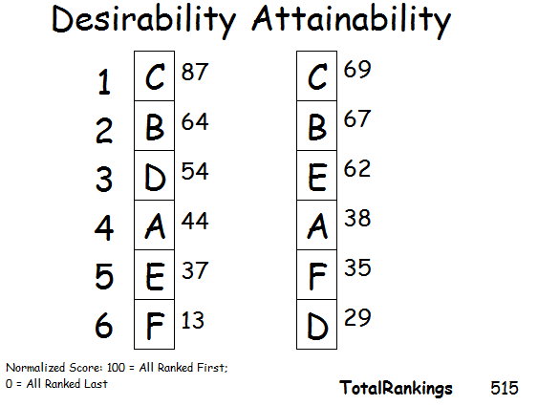
A: Wild Park
B: A Usable Park
C: The Sustainable Life
D: Adirondack County
E: Post “Big Gov’t” Solutions
F: Adirondack State Forest
Wide Support for C: The Sustainable Life Scenario
C and B tied for Attainability
Most Desirable = Most Attainable (a 1st for us)

Slide 5
The Combined Model
B: Sustainable Recreational Tourism and Early Retirees
C: Sustainable Life
+
A: Wild Forest Preserve

Slide 6
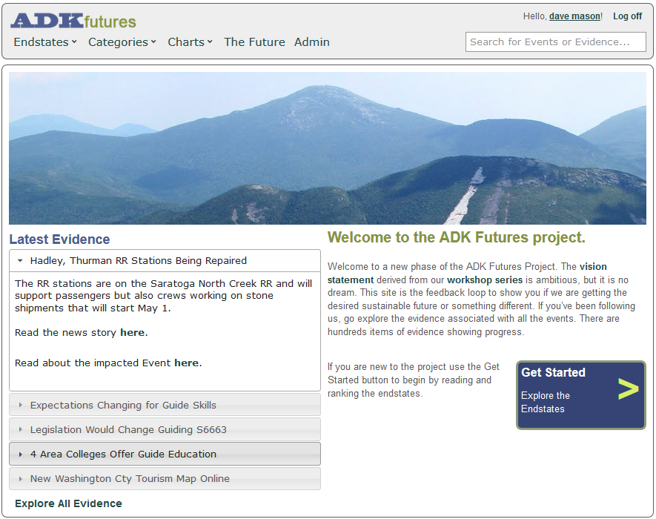
So What has Happened?
Where is there progress?
Where is it stalled?

Slide 7
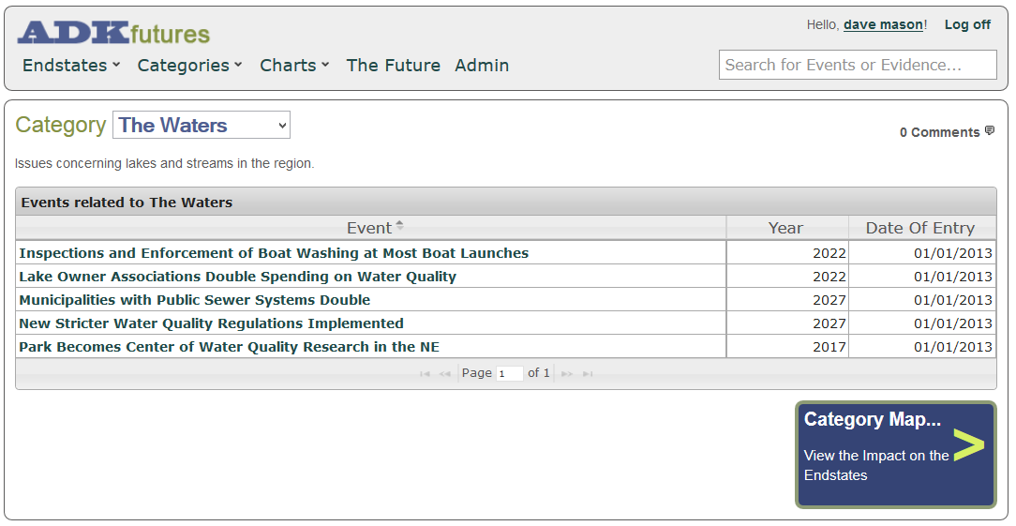

Slide 8
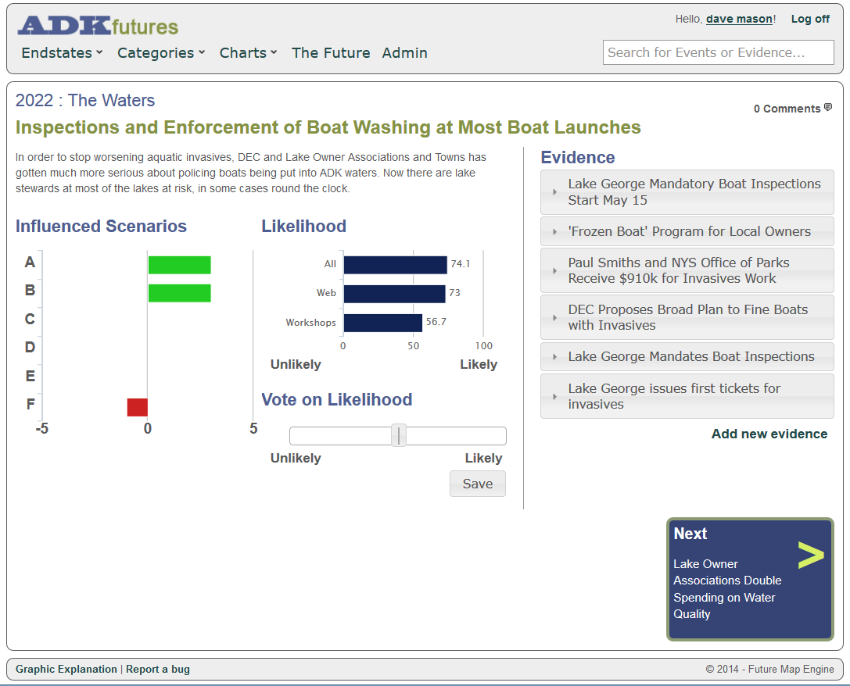
Pick an Event of Interest
There are 133 events divided into 16 categories

Slide 9
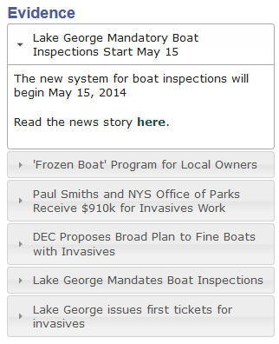
Pick an Item of Evidence of Interest
There are about 500, associated with events click on the link….

Slide 10
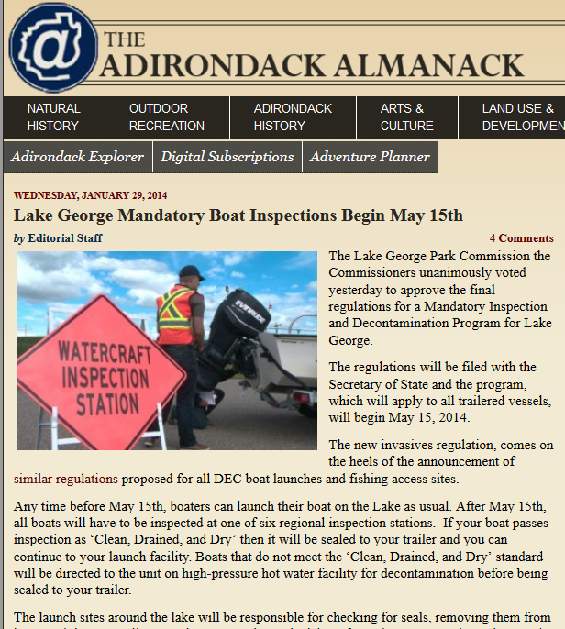
Read the story behind the evidence for details…
Press stories, reports, government announcements, businesses, websites, etc.
18-24 months of data

Slide 11
Conference Topics
Energy: Biomass, 5 energy demo projects
Water quality, climate change, acid rain recovery, citizen science, road salt
Local economic developments, local food and farm services, biotech, StartupNY, Point Positive
Recreational tourism: trail use database, smart phones in research, an explosion in map data,
Demographic issues
Colleges as economic drivers

Slide 12
Energy
Renewables are an economic localization story
  Biomass is a close-by fuel for us, we won’t ever get much pipeline gas
  Thermal baseload heat for large buildings is the sweet spot, displacing oil
  We have 800,000 acres of industrial forest that will be harvested forever
Our biomass progress is slow. A handful of schools. (VT has biomass in 60% of it’s schools). A handful of commercial projects.
Energy finance innovations are helping.
New interest in using existing dams for hydro. There are many small hydro operations but there used to be more.
Innovative pumped storage project using old mine tunnels in Mineville
Biodigesters for food waste and dairy farms
Solar is seeing residential and municipal applications. We need Community Net Metering (S4722) to make solar an option for most people.
NOTE: 95% of our electricity is not fossil fueled: mostly hydro, 4% is from wind in the St Lawrence Valley and biomass rounds out the total

Slide 13
Climate Change Impacts, Environment
Newcomb ice records show shorter winters
Winter logging season shorter
Impacts showing on farms
  Longer growing season, Apple trees blooming 8 days earlier
Some boreal birds declining, other showing up (snowy owls, ptarmigan)
Millions more to be spent replacing Irene damaged bridges and resilience plans in Keene and Jay, integrating natural and built infrastructure
Acid rain recovery, focus on mercury, road salt and alternatives
Citizen science aimed at invasives, wildlife tracking, wetlands phenology
125 new weather stations all across NYS, instrumentation of Lake George
Climate change skeptics remain around 23% or lower

Slide 14
Economic Development
Invasives and the economic value of clean water
Trudeau/Clarkson Biotech effort, StartUp NY and Point Positive working on new businesses
Local food and farm services, growth in milk for yogurt, solar energy to extend the growing season
Lake George, SLK, Port Henry, Northville, Lyons Falls, others working on Main Street projects
Center for Working Landscapes at Paul Smith’s: encompasses farming and food, forestry for energy, building materials, water, and a tourism industry rooted in our landscape
Large projects around the Park doing well: Global Foundries expanding now, Bombardier, Nova Bus, Nano Utica, Rome drone testing site
Broadband construction programs now in 9 towns, more to come; cellphone projects all over

Slide 15
Demographics
National trends are rural to city, cold to warm, the graying baby boom but…..
  2013-14 tri-lakes school enrollments mostly flat
  Some early evidence that broadband does bring in young families (Keene had the largest kindergarten in a decade)
  New Essex County report shows a bump up in 20-24yo cohort
Aging of the population: A threat or an opportunity?
  Are the boomers moving in? What will it mean to our economy if they do?
A few high schools, Paul Smiths, NCCC bringing diversity to some areas
NYS cities have much worse poverty problems than Essex (12.4%) and Hamilton (8.8%)
  20% in NYC live in poverty, 20% more in near-poverty, the City is 1/3 white today

Slide 16
Recreation
Regionalization of tourism marketing and promotion
Guiding becoming professionalized: 4 area colleges offer guide education
Trail use database and an explosion of new GIS maps
46er registrations, in 2012, jumped from 288 to 700
Inter-hamlet paths growing: Inlet to Raquette Lake, Wadhams to Essex, Essex to Westport
Smaller trail systems getting more promotion: SLK 6ers, CATS
NYS investments
  >20 waterfront park improvement projects in progress
  Whiteface is getting a highway rebuild, Gore has 100 new snowguns and a new chairlift
  3 snowmobile trail groomers
  2 pond restoration projects, hatchery rebuilds
Adding or renovating accommodations in Schroon, Lake Placid, SLK, Speculator

Slide 17
The Big Open Challenges
Transportation and thermal heat energy
Adaptation to climate change
Regional demographics diverging from NYS
Targeting retiring boomers as a growth population for the region
Successful small school system operations
New approaches to government in the region
Other important projects in play
  Attracting private investment in businesses
  New approaches to health care, e.g. telemed, Medical Home, Acountable Care Organizations, Blue Line Group redesign of elder care services
  Shifting to better integrated, landscape scale, planning
  Shifting to a new power grid and decentralized power production

Slide 18
ADK Futures Update
“The first step to better times is to imagine them”
a Chinese fortune cookie
Then what happens? Stay tuned
Adirondack Research Consortium
Lake Placid, May 2014
Dave Mason and Jim Herman

