Slide 1
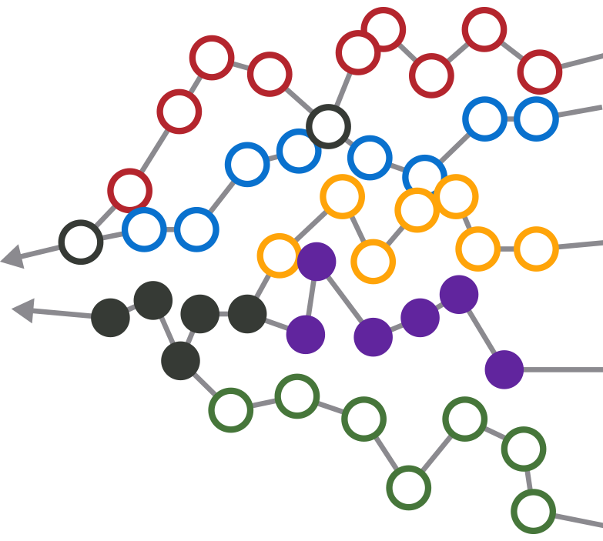
ADKfutures
UPDATE ONE, 4 years out

Slide 2
CGA Workshops Mapped Event Paths to 5 Endstates from Sept. 2011 to June 2012
WE FACILITATED SESSIONS THAT CONNECTED EVENT PATHS TO FIVE ENDSTATES
STAKEHOLDERS HAD RICH STRATEGIC CONVERSATIONS ON POSSIBLE FUTURES
“I never realized what events would need to occur in order to reach the orange endstate.”
PRESENT DAY
“I always thought the purple endstate was most desirable, so let’s talk about how to make it attainable.”
“I had never seriously considered the green endstate. It makes me uncomfortable because it’s feasible and we can’t do well at all in this future-- let’s figure out how we can avoid this endstate.”
= possible future event
= possible endstate

Slide 3
Event Paths Provide a Framework to Monitor Progress
THE FUTURE MAP FORMS THE BASIS FOR IMPLEMENTATION PLANNING AND ONGOING EVENT MONITORING
“We want to proactively create this future, and we understand the events required…
...but we’re able to collectively change course sooner (and without a time-consuming decision-making process) if a different future emerges”
YOUR ORGANIZATION’S CURRENT STATE
COMMON event
TURNING POINT event
= possible future event
= possible endstate

Slide 4
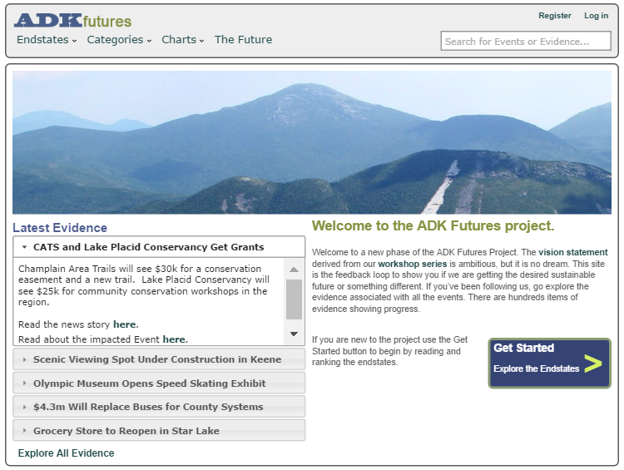
ADKfutures.net
The database of news and developments about the success or failure of each event can be found on:
www.ADKfutures.net
There are about 1000 items of evidence
To be included something has to happen
A decision, approval or grant
Something opens or closes
Human and natural events
Someone does something

Slide 5
This Update is Organized by Event Category Topic
This update was written in February 2016
  A printed copy is available here today
The online version on www.ADKfutures.org has extensive live links to sources supporting evidence citations
Regulation moves slowly, but much done on economic development, recreation and water quality

Slide 6
Community – Something in the air…
CGA continues to meet annually. Happy 10th anniversary! The alignment it generates helps bring State funds and attention to the region. It is amazing.
  Time and again CGA has proven we gain strength from alignment
Philanthropy: Newcomb and Cranberry Lake received bequests in the millions via the Adk Foundation
Park-wide summit meetings on five topics
  Adk Non-Profit Network, ADK Foundation
  Birth-to-3 Alliance, ADK Foundation
  Tourism, ROOST
  Arts and Culture, ADK Action
  Diversity Symposiums, Adk Diversity Advisory Council
Lots of smaller efforts: tidy town projects, Winter46r, Leanto Rescue, ARISE in Tupper, four citizen science projects and ADK Gives, making philanthropy accessible to all

Slide 7
Demographics
Total population is flat, trending older, low share of 20-40yo parenting age group
We will reach a median age of 50 fairly soon
We have classic rural demographics, perhaps a bit better
Bright spots: Champlain Valley young farmers, Saranac Lake
Diversity is now a much higher profile issue
Some boomers do retire here in the earlier years, but often leave as older seniors

Slide 8
Economic Development
Most of this work is split among three REDCs. They have succeeded beyond expectations in winning development funding
Manufacturing growing around the Park, semiconductors in Saratoga and Utica/Rome, subway cars and busses in Plattsburgh, boats in Queensbury, etc
Advantage Adirondacks project laid out a set of identity options for towns – art towns, ‘trail towns’, etc
Seven towns are working with Main Street Revitalization grants. Patience please.
Point Positive, Saranac Lake, is a new angel investing group has funded 4 companies, it needs more investors.
Broadband has made lots of progress but is years from completion and only part of any success story. Patience please.
Clean-up of the 3000 acre J&L mine site in Clifton is underway. Reconstruction of rail access is under contract.
Micro grant programs have come to Tupper Lake and Essex County

Slide 9
Clean Energy, Solar Sweet Spot
Solar, large wind farms in the St Lawrence Valley, and existing dams produce 3x the power consumed in the North Country REDC
  Rebuilt transmission lines will reach New England and link NYC to Canadian hydro power
  Pumped storage project in the old mine tunnels in Moriah is in late permitting
Solar PV, has benefited from cost declines, is attractive, expanding. Community solar now legal up to 2mw, about 10 acres.
Biomass for power has fallen on hard times due to oil prices. There is some biomass heat installed but not what was hoped for. Loggers are being laid off now.

Slide 10
Agriculture is Developing
Local food is a big success. Support services are growing. Attracting more conservation easement funding
This is bringing a parenting age cohort here
CSA style farming is turning into a social community, institutional CSAs
Farm stay vacations using AirB&B are growing
Local food programs in schools and restaurants growing
Local brewers in all larger towns, distilleries coming, grapes, and hops crops
Chester hosts one of the new NYS certified medical marijuana growers
Two season extension projects starting

Slide 11
Promotion is Working
ROOST stepped into the role of unifying regional marketing
NYS has regularly funded a range of promotional campaigns. Transit campaigns in NYC have been very effective.
Events provide marketing themes all over the region. Fishing tournaments, art and music festivals, winter and summer sports events, food events, town-wide garage sales – it is endless.
Lake Placid sports events bring TV coverage of the region
New facilities like the Wild Walk, new exhibits at the ADK Museum, new outdoor performance space in Lake George all boost visits.
Expansion of cell service is moving lots of tourism info to smart phones. New types of driving tours are developing. New forms of promotion coming.

Slide 12
Recreation is Growing
NYS has funded dozens of recreation projects. New docks, parking, bike trails, visitor centers, waterfront parks, camp repairs, dam and lock renovations, fire tower restorations, fishing pond restorations, sports fields, performance spaces, camp ground upgrades …
Private investments in new hotels and renovations in Speculator, Saranac Lake, LP, LG, Schroon Lake, Ticonderoga, Warrensburg
Other private investments: several marinas, high end camping, a wave park, a zip line, a farm resort, and an old dude ranch turning into a science camp and family resort
A hut-to-hut system has been planned
Networks of snowmobile trails connecting isolated hamlets hope to boost winter tourism
Short trail systems like CATS, Lake George trails, Henry’s Woods in LP, the Saranac Lake 6er are attracting much heavier use.
Back country use is up even in winter.
Cycling is growing in several forms: Iron Man in LP, trail biking in Wilmington, the WCS Bike the Park tour, family biking in the Essex Chain

Slide 13
Arts and Culture
All the movie theaters made the digital conversion, thanks ANCA!
Two feasibility studies for replacement theaters underway
Lake George is building a significant music festival
Wild Walk is a major success, new exhibits are coming soon to the Adk Museum
Ft Ticonderoga connecting to its Champlain waterfront
John Brown Lives and the Underground Railroad Museum are running
AARCH tours are often oversubscribed
Driving ‘trails’ like Lake-to-Locks, First Wilderness Heritage Corridor and an Arts Trail
Even a StarTrek fan studio has opened

Slide 14
Healthcare Survived
The shift to wellness health care and ACA implementation has been hard. Hospital admissions dropped, primary care investments made in at least 4 new clinics. None closed.
  Large new Hudson Headwaters Health clinic in Warrensburg
  Adk Health and Elizabethtown CH have embarked on major capital spending programs. The Lake Placid hospital will be replaced.
  Elizabethtown, Plattsburgh and Malone hospitals have merged with Burlington VT.
New assisted living and memory care in Willsboro. Three nursing homes have changed owners, none closed.
  Lack of home health care in Hamilton County is a dire problem.
NYS insurance exchange has brought new options to the region for better coverage at lower cost
Telemed network is operational, reaching every health center
The shortage of EMT volunteers is real. Changing to paid staff is complicated and slow.

Slide 15
Transportation
Plattsburgh airport is opening nine gates and, soon, International Customs
  Watertown has flights to Chicago, Ogdensburg will get flights to Florida
Amtrak NYC to Montreal has seen some track improvements.
  Amtrak doing creative marketing to Ticonderoga, Westport to LP connecting van service
  Continued improvements are expected and needed due to oil trains
Bus services are in need of study and development
Two of the three tourist train runs appear financially weak but they’re not giving up yet
Electric vehicle charging stations starting to appear
Environmental steps: different winter de-icing methods, demonstrations of new open-bottom culvert designs, two porous pavement projects, Ausable watershed bridge replacements
Driving tours: the Olympic Trail, Arts Trail, First Wilderness Trail, Lakes-to-Locks Passage, etc – all are moving to mobile phone applications. Similar ideas developing for water passage ‘blue ways’

Slide 16
Education
Two small districts ceased operations, tuition students to neighboring schools. The only proposed merger was rejected. There are a few examples of shared services.
Some districts attract tuition students from nearby towns
Foreign students boost enrollment, but it weakens with the strong dollar
Several colleges offer entrepreneurial programs
Several colleges offer guide training programs
Paul Smiths College has strong job track programs. Challenged by a shrinking pool of potential applicants.

Slide 17
Government is Slowly Shrinking
Village of Keesville dissolved. Port Henry is in the process. Towns of Clifton and Fine are discussing the merits of merging. Essex and Willsboro are increasingly aligned.
Some 911 dispatch has been consolidated. Hamilton Cty has consolidated fuel purchases.
A few towns have Comprehensive Land Use Plans. But it is easier and cheaper to leave responsibility for approving projects to the APA.
Government Jobs
  NYS has moved strongly to online service delivery for DMV, sports licenses and the health insurance exchange
  Two prisons have closed, continuing reductions seem likely
  Sunmount cut its resident population by 1/3

Slide 18
Regulation
Two Article 14 amendments passed: the NYCO mine expansion and TWP 40 deed resolution.
Two are in process:
  Won 1st passage: A land bank for various town and county purposes and allowing buried utilities in road ROWs. This is a big deal that a lot of people worked on for a long time. Thanks to everyone involved.
  Still under study: Sale of the old prison in Brighton
Great South Woods and the ‘5 Towns’ projects are ongoing experiments in larger landscape planning
Some revisions to the SLMP approved, discussion of a larger overhaul, nothing ongoing
New recreation uses (eg bikes, back country skiing) and new lands create new points of robust discussion.
Transferrable development rights continue to be discussed
The APA is generally respected and heeded. Where some see shifts in APA permitting, others see proper application of the law. Such conflict comes with the mission.

Slide 19
Climate Change
Progress is a mixed bag
Winter visitors are 30% of tourism, the season with the largest climate change impacts
  But shoulder seasons can get longer and stronger.
We will be a refuge for species moving north, biodiversity should increase
State is active in RGGI, power plant emissions in NYS are down 40% since 2005
The Youth Climate Summit at TWC is going national, global, winning awards
FEMA flood damaged homes have been removed. New demo culvert designs have been built. Widespread bridge replacement continues 5 years after Irene. Lesson: Recovery is a very long process.
Dams are often being removed or abandoned after flood damage, not repaired

Slide 20
The Forest
Competed the historic Finch land acquisitions and the Elk Lake conservation easement
Some effort, but no notable success, in stopping insects attacking several tree species
DEC has controlled the feral swine problem

Slide 21
The Waters
Creation of a region-wide boat washing system to combat invasives is a big, trust-building, win
  Road salt action is shaping up to be the next big thing
Lake George ‘smart lake’ project and numerous water quality actions taken in the LG watershed
Citizen science work on wetlands and invasives
Infrastructure Work
  Two new sewer systems (Inlet and Essex) are online
  Continuing work toward rebuilding existing systems in three towns
  Four new drinking water supply systems still needed
  Big $10m cleanup project slated for Lake Flower, Pontiac Bay
Acid rain impacts reversing

Slide 22
This was the 2012 project summary
2016
C: Sustainable Life, will have ups and downs due to need for behavior changes
100%
C
B: Recreation Park, starts high, improves, then tapers off
B
A: Wild Park, forest preserve is
solid
A
D
E: On Your Own: slow fade as we act more regionally
D: Regionalize, will grow slowly early, then take hold
E
0%
2012
2025
2037

Slide 23
ADK Futures
We will continue to track actions against the future map for the region through ADKfutures.net
  Now at 1000 items of evidence
  Next report at 2000 items
  Always online for everyone to view at ADKfutures.net
We will blog occasionally at AdKfutures.org
A lot has happened and continues to happen
Thank you for your hard work and support for the region. There is plenty for many people to be proud of!

