Slide 1
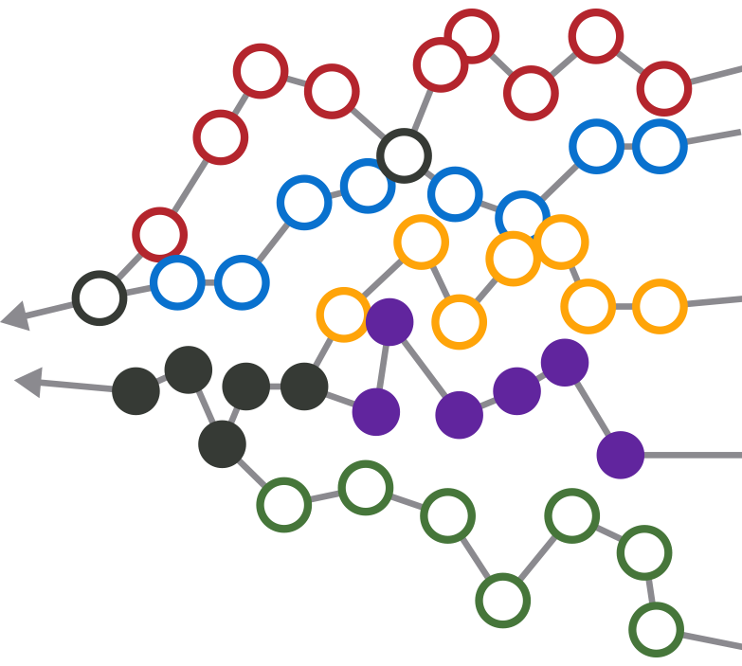
ADK futures
Year 5 Update
July 2017 APA meeting, Dave Mason

Slide 2
CGA Workshops Mapped Event Paths to 5 Endstates from Sept. 2011 to June 2012
WE FACILITATED SESSIONS THAT CONNECTED EVENT PATHS TO FIVE ENDSTATES
STAKEHOLDERS HAD RICH STRATEGIC CONVERSATIONS ON POSSIBLE FUTURES
“I never realized what events would need to occur in order to reach the orange endstate.”
PRESENT DAY
“I always thought the purple endstate was most desirable, so let’s talk about how to make it attainable.”
“I had never seriously considered the green endstate. It makes me uncomfortable because it’s feasible and we can’t do well at all in this future-- let’s figure out how we can avoid this endstate.”
= possible future event
= possible endstate

Slide 3
Event Paths Provide a Framework to Monitor Progress
THE FUTURE MAP FORMS THE BASIS FOR IMPLEMENTATION PLANNING AND ONGOING EVENT MONITORING
“We want to proactively create this future, and we understand the events required…
...but we’re able to collectively change course sooner (and without a time-consuming decision-making process) if a different future emerges”
YOUR ORGANIZATION’S CURRENT STATE
COMMON event
TURNING POINT event
= possible future event
= possible endstate

Slide 4
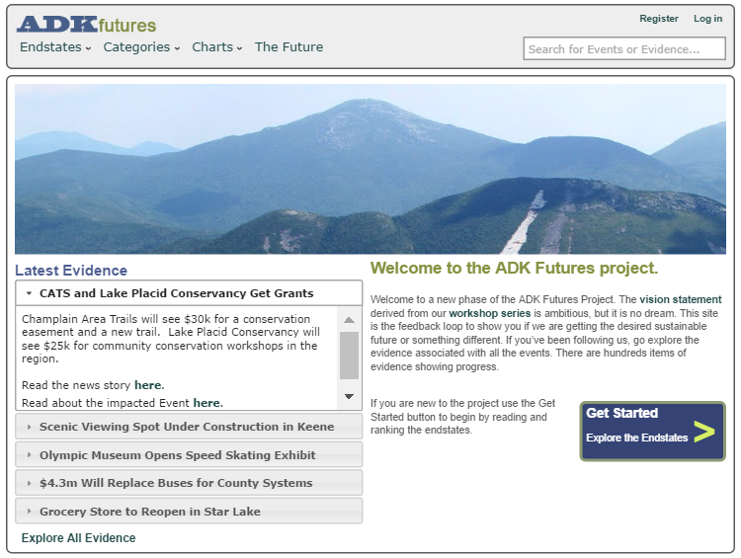
ADKfutures.net
The database of news and developments about the success or failure of each event can be found on:
www.ADKfutures.net
There are about 1215 items of evidence
To be included something has to happen
A decision, approval or grant
Something opens or closes
Human and natural events
Someone does something

Slide 5
This Update is Organized by Event Category Topic
The online version on www.ADKfutures.net has extensive live links to sources supporting evidence citations
Regulation moves slowly, but much has happened on economic development, recreation and water quality

Slide 6
Economic Development
The REDCs have succeeded far beyond expectations in winning funding
Manufacturing growing around the Park, semiconductors in Saratoga, drones in Utica/Rome, subway cars and busses in Plattsburgh, Norsk Titanium, boats in Queensbury, etc.
Advantage Adirondacks project laid out a set of identity options for towns – art towns, ‘trail towns’, etc
Seven towns now working with Main Street Revitalization grants. Patience please.

Slide 7
Economic Development 2
Broadband has made lots of progress. Patience please.
Point Positive, Saranac Lake, is a new angel investing group has funded 5 companies, it needs more investors.
Clean-up of the J&L mine site in Clifton is underway. Reconstruction of rail access is under contract.
Micro grant programs have come to Tupper Lake and Essex County
Rail Trail plan is track to Tupper, then trail onward to Lake Placid
Frontier Town gateway project is advancing
A ‘hut-to-hut’ style hiking system is being planned

Slide 8
Recreation is Growing
New hotels and renovations in Speculator, Saranac Lake, LP, LG, Schroon Lake, Ticonderoga, Warrensburg
Other investments: several marinas, high end camping, a wave park, a zip line, a farm resort, and a restored ranch resort, the formal land purchase by ACR in Tupper
NYS has funded dozens of recreation projects.
  New docks, waterfront parks, fishing pond restorations, dam and lock renovations
  Parking areas, bike trails, visitor centers, camp repairs, fire tower restorations, camp ground upgrades, trail crews
  Sports fields, performance spaces

Slide 9
Recreation is Growing 2
Networks of snowmobile trails are connecting some hamlets
Back country use is up, even in winter
Short trail systems like CATS, Lake George trails, Henry’s Woods in LP, the Saranac Lake 6er all attracting much heavier use
Cycling is growing in several forms: Iron Man in LP, trail biking in Wilmington, the WCS Bike the Park tour, ANCA Bike the Barns
Crowds in the High Peaks are a problem again

Slide 10
The Waters
The regional boat washing system to combat invasives
Lake George ‘smart lake’ project and numerous water quality actions taken in the LG watershed
Acid rain impacts are reversing
Road salt reduction experiments are happening
Spiny water flea disappeared from Lake George!
Water project circuit rider now on the job
  Two new sewer systems (Inlet and Essex) are online
  Elizabethtown moving toward its first system, Corinth, LP, LG moving toward upgrades
  Four new drinking water supply systems needed. Tupper and Crown Pt are funded.
  Big $10m cleanup project slated for Lake Flower, Pontiac Bay.
Citizen science work on wetlands and invasives

Slide 11
Clean Energy, Solar Sweet Spot
Solar PV, is expanding and bringing jobs to the region
Community solar now legal up to 2mw, about 10 acres. At least one project expected to be operating by year end.
Biomass for electricity has fallen on hard times due to oil prices
There is some biomass heat installed but not what was hoped for.
Ti paper mill has switched from oil to gas
Pumped storage project in the old mine tunnels in Moriah is in late permitting

Slide 12
Agriculture is Developing
This is bringing a parenting age cohort here. Watch Keeseville area census figures.
Support services e.g a food hub and a slaughter house have been established
Attracting more conservation easement funding
CSA style farming is turning into a social community, institutional CSAs
Farm stay vacations using AirB&B are growing, cuisine trails organizing
Local food programs in schools and restaurants growing

Slide 13
Agriculture is Developing 2
Local brewers in all larger towns, distilleries coming, cold weather grapes, and hops crops. Craft beverage campus in Lake George.
Chester hosts one of the new NYS certified medical marijuana growers
Small dairy and cheese operations are growing
Several season extension projects operating, more coming
Remote area food distribution remains an issue

Slide 14
Arts and Culture
All the movie theaters made the digital conversion, thanks ANCA!
Two feasibility studies for replacing performance theaters underway
Lake George is building a significant music festival
Wild Walk is a big success at TWC
New exhibits open at the Adirondack Experience
Ft Ticonderoga connecting to its Champlain waterfront

Slide 15
Arts and Culture
John Brown Lives and the Underground Railroad Museum are running
AARCH tours are often oversubscribed
Driving ‘trails’ like Lake-to-Locks, First Wilderness Heritage Corridor and an Arts Trail
Even a StarTrek fan studio has opened
Integrated arts calendar is operational

Slide 16
Promotion is Working
NYS has regularly funded a range of promotional campaigns
ROOST stepped into the role of unifying regional marketing and booking
Events provide marketing themes all over the region
  Fishing tournaments
  Art and music festivals
  Winter and summer sports events
  Food events
  Town-wide garage sales
  it is endless……………………….

Slide 17
Promotion is Working 2
Expansion of cell service is moving lots of tourism info to smart phones. New types of driving tours are developing.
Air B&B is booming here
New marketing aiming at millennials

Slide 18
Transportation
Plattsburgh airport will open nine gates and Int’l Customs
  Watertown has flights to Chicago, Ogdensburg has flights to Florida
Uber and Lyft are now legal here
Amtrak NYC to Montreal has seen some track improvements
  Amtrak doing creative marketing to Ticonderoga and LP connecting van service from Westport
Bus services are in need of study. What exists? What is needed?

Slide 19
Transportation 2
Environmental steps taken
  Demonstration of new open-bottom culvert designs
  Two porous pavement projects
  Ausable watershed bridge replacements
  Testing different winter de-icing methods
Electric vehicles appearing
  Charging stations starting to appear
  Self driving vehicles closer than was thought 5 years ago

Slide 20
Climate Change, a Mixed Bag
Winter visitors are 30% of tourism, the season with the largest climate change impacts
  Uneven winter weather causes big problems for sports events, cancellations
  But shoulder seasons can get longer and stronger
State is active in RGGI, power plant emissions in NYS are down 40% since 2005
The Youth Climate Summit at TWC is going national, global, winning awards
We will be a refuge for species moving north, biodiversity should increase
A few towns doing DEC Climate Action Plans

Slide 21
Climate Change, a Mixed Bag 2
Recovery from Irene is largely done, 6 years of work
Old dams are often being removed, not repaired
Lyme disease increasing due to warmer winters
Flood zone map updates still not finished

Slide 22
Government is Slowly Shrinking
Villages of Keeseville and Port Henry dissolved. Essex and Willsboro are increasingly aligned.
Some 911 dispatch has been consolidated. Hamilton Cty has consolidated fuel purchases.
Circuit riders in the field for solar, water/sewer projects
A few towns have Comprehensive Land Use Plans. But it is easier and cheaper to leave responsibility for approving projects to the APA.
Government Jobs
  NYS has moved strongly to online service delivery for DMV, sports licenses and the health insurance exchange and webcasting meetings
  Two prisons have closed, continuing reductions seem likely
  Sunmount cut its resident population by 1/3
LP voters rejected court consolidation twice

Slide 23
Healthcare Survived so Far
The shift to wellness health care and ACA implementation has been hard. Hospital admissions dropped. Primary care investments made in at least 4 new clinics.
  Large new Hudson Headwaters Health clinic in Warrensburg
  Adk Health and Elizabethtown CH have embarked on major capital spending programs. The Lake Placid hospital is being replaced.
  Elizabethtown, Plattsburgh and Malone hospitals have merged with Burlington VT.
New assisted living and memory care in Willsboro. Three nursing homes have changed owners, none closed.
NYS insurance exchange increased choice, improved coverage at lower cost. Medicaid expansion insured thousands.

Slide 24
Healthcare 2
Telemed network now reaches every health center, usage growing
Wellness Institute in Westport begins programs summer 2017
Birth-to-Three and aging-in-place care projects launched by Adk Foundation
Opioid detox center to open in Clinton Cty
The shortage of EMT volunteers is a known problem, solutions being studied
Lack of home health care in Hamilton County is a dire problem

Slide 25
Education K-12
Level enrollments in the Tri-Lakes is viewed as good news
Two small districts ceased operations, tuition students to neighboring schools. The only proposed merger was rejected. There are a few examples of shared services.
Some districts attract tuition students from nearby towns
Foreign students boost enrollment, but likely to weaken due to a strong dollar, anti-immigrant sentiments

Slide 26
Education Colleges
Several colleges offer entrepreneurial programs
Several colleges offer guide training programs
Paul Smiths College has strong job track programs. Challenged by a shrinking pool of potential applicants, low price SUNY programs

Slide 27
The Forest
Completed the Finch land acquisitions and the Elk Lake conservation easement
Some effort, but no notable success, in stopping insects attacking several tree species
  Emerald Ash Borer be killing ash trees
  Oak Wilt will be killing oak trees
  Adelgids will be killing balsam and hemlock forests common on lake shores
DEC has controlled the feral swine problem

Slide 28
Community – Something in the air…
CGA continues meeting annually. Regional alignment it generates helps bring State funds to the region.
Park-wide summit meetings on various topics
  Tourism, ROOST growing across the region
  Adk Non-Profit Network, ADK Foundation
  Birth-to-3 Alliance, ADK Foundation
  Diversity Symposiums, Adk Diversity Advisory Council
  Arts and Culture, ADK Action
  Road Salt, ADK Action
  Tax Assessors, ADK Action

Slide 29
Community 2
Philanthropy: Newcomb and Cranberry Lake received bequests in the millions via the Adk Foundation
Lots of smaller efforts: Winter46r, Leanto Rescue, ARISE in Tupper, four citizen science projects and ADK Gives
Not much progress on affordable housing

Slide 30
Demographics
Total population is flat, trending older, low share of 20-40yo parenting age group
We will reach a median age of 50 fairly soon
Bright spots: Champlain Valley young farmers, Saranac Lake
Some boomers retire here in their earlier years, but often leave as older seniors
Little or no effort trying to attract retiring boomers or refugees
Diversity is now a much higher profile issue

Slide 31
Regulation
Two Article 14 amendments passed: the NYCO mine expansion and TWP 40 deed resolution.
Two are in process:
  Won 2st passage: A land bank for health, safety, utility purposes and allowing buried utilities in road ROWs. This is a big deal that a lot of people worked on for 5 years
  Still ahead: Sale of the old prison in Brighton
Great South Woods and the ‘5 Towns’ projects are ongoing experiments in larger landscape planning
Transferrable development rights continue to be discussed

Slide 32
Regulation 2
Small revisions to the SLMP approved, w/continued discussion of a larger overhaul but nothing ongoing
New recreation uses (eg bikes, back country skiing) and new lands create new points of robust discussion
The APA is generally respected and heeded. Where some see shifts in APA permitting, others see proper application of the law. Legal conflicts come with the APA mission.

Slide 33
This was the 2012 project summary
2017
C: Sustainable Life, will have ups and downs due to need for behavior changes
100%
C
B: Recreation Park, starts high, improves, then tapers off
B
A: Wild Park, forest preserve is
solid
A
D
E: On Your Own: slow fade as we act more regionally
D: Regionalize, will grow slowly early, then take hold
E
0%
2012
2025
2037

