Slide 1
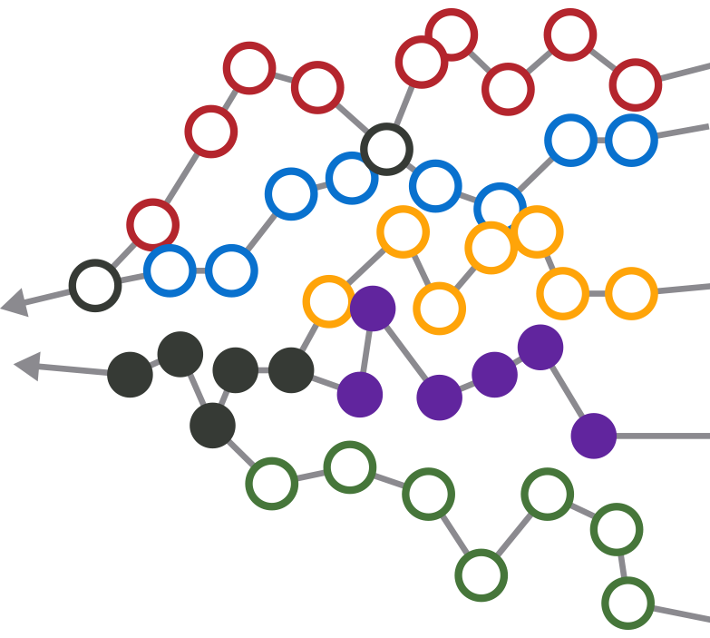
ADK futures
Year 7 Update (7 of 25)
March 2019
Dave Mason

Slide 2
CGA Workshops Mapped Event Paths to 5 Endstates from Sept. 2011 to June 2012
WE FACILITATED SESSIONS THAT CONNECTED EVENT PATHS TO FIVE ENDSTATES
STAKEHOLDERS HAD RICH STRATEGIC CONVERSATIONS ON POSSIBLE FUTURES
“I never realized what events would need to occur in order to reach the orange endstate.”
PRESENT DAY
“I always thought the purple endstate was most desirable, so let’s talk about how to make it attainable.”
“I had never seriously considered the green endstate. It makes me uncomfortable because it’s feasible and we can’t do well at all in this future-- let’s figure out how we can avoid this endstate.”
= possible future event
= possible endstate

Slide 3
Event Paths Provide a Framework to Monitor Progress
THE FUTURE MAP FORMS THE BASIS FOR IMPLEMENTATION PLANNING AND ONGOING EVENT MONITORING
“We want to proactively create this future, and we understand the events required…
...but we’re able to collectively change course sooner (and without a time-consuming decision-making process) if a different future emerges”
YOUR ORGANIZATION’S CURRENT STATE
COMMON event
TURNING POINT event
= possible future event
= possible endstate

Slide 4
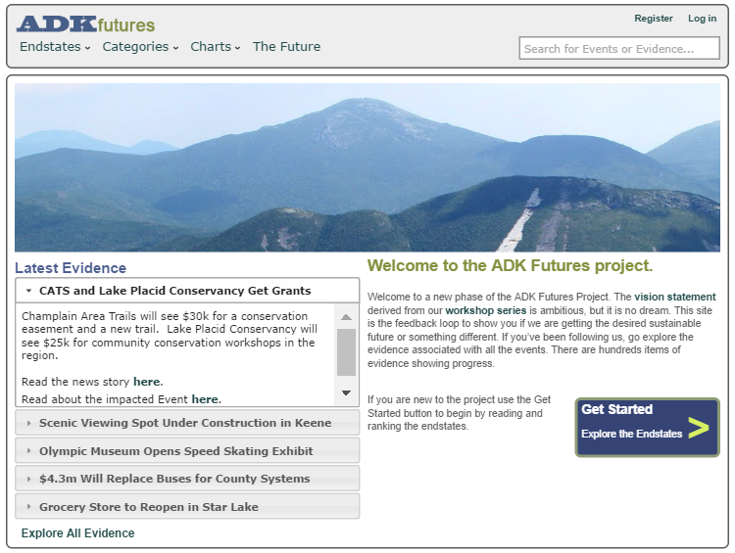
ADKfutures.net
The database of news and developments about the success or failure of each event is on:
www.ADKfutures.net
There are about 1387 items of evidence
To be included something has to happen
A decision, approval or grant
Something opens or closes
Major natural events

Slide 5
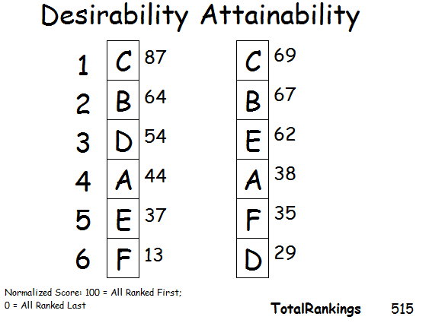
ADK Futures
Result
Wide Support for C: The Sustainable Life Scenario
Also for B: Recreation
C and B tied for Attainability
Most Desirable = Most Attainable

Slide 6
This was the 2012 project summary
2019
C: Sustainable Life, will have ups and downs due to need for behavior changes
100%
C
B: Recreation Park, starts high, improves, then tapers off
B
A: Wild Park, forest preserve is
solid
A
D
E: On Your Own: slow fade as we act more regionally
D: Regionalize, will grow slowly early, then take hold
E
0%
2012
2025
2037

Slide 7
This Update is Organized by Event Category Topic
www.ADKfutures.net has live links to sources supporting all evidence citations

Slide 8
Recreation is Growing
New hotels and renovations in Speculator, Saranac Lake, LP, LG, Schroon Lake, Ticonderoga, Warrensburg, Etown
  More coming in Inlet, Tupper
  Hamilton County beds still shrinking
  Air B&B bigger than traditional lodging, adding TentRR, a camp site version
NYS has funded dozens of recreation projects
  New docks, waterfront parks, fishing pond restorations, dam and lock renovations, ski mountain upgrades, I-87 welcome center at Exit 18.
  Bike trails, camp repairs, fire tower restorations, camp ground upgrades, trail crews, parking areas
  Sports fields, performance spaces, Frontiertown project
First property sales at the ACR in Tupper

Slide 9
Recreation is Growing 2
Other investments: several marinas, glamping sites, a wave park, zip lines, a farm resort, and a restored ranch resort
Snowmobile trails are connecting some hamlets
‘Hut-to-Hut’ tourism in testing now. 59 trips designed.
Short trail systems e.g. CATS, Lake George trails, Henry’s Woods in LP, the Saranac Lake 6er, Chester, Tupper, Moriah, etc. all report heavier use
Cycling is growing in several forms: Iron Man in LP, trail biking in Wilmington, the WCS Bike the Park, ANCA Bike the Barns
Back country use is up, even in winter. Crowding and parking are issues on some days in some places.
  No major new fees or reservation systems. Parking is being restricted, moved, fee based.

Slide 10
Economic Development
The REDCs succeeded in winning funding far beyond expectations
Broadband and cell service has made lots of progress
Manufacturing growing around the Park, semiconductors in Saratoga, drones in Utica/Rome, transportation manufacturing in Plattsburgh, boats in Queensbury, etc.
  SLK and Willsboro see grants for manufacturers
  Clean-up of the J&L mine site in Clifton finished Phase 2. Reconstruction of rail access is under contract.
Seven towns working with Main Street Revitalization grants. 14 towns get smart growth grants. 3 towns get property renovation grants.
Ecotourism proving successful, e.g Wild Walk, LG floating classroom, Adk Observatory

Slide 11
Economic Development 2
Point Positive, the angel investing group, has funded 8 companies
Ignite, a regional KickStarter, launched by ANCA, along with a project to help boomers sell their businesses
Micro grant programs have come to Tupper Lake and Essex Cty
Variety of NYS policies changed to help farms and small business
LG gateway project, year-round push
Advantage Adirondacks project laid out a set of identity options for towns – art towns, ‘trail towns’, etc

Slide 12
The Waters
AWI was successful creating a regional boat washing system
More watershed plans in place will lead to funding
Road salt reduction efforts, science work, salt storage sheds
Storm water management getting more attention
Lake George ‘smart lake’ project and numerous water quality actions taken in the LG watershed, boat user fees increased
Water project circuit rider now on the job
  Two new sewer systems (Inlet and Essex) are online
  Elizabethtown sewer moving again, 10 existing systems moving toward upgrades
  Four new drinking water systems funded: Tupper, Crown Pt, Lewis, Saranac
  Big cleanup project in SLK for Lake Flower, Pontiac Bay
Acid rain impacts reversed, but the rules are weakening
Citizen science work on wetlands and invasives

Slide 13
Agriculture is Strengthening Communities
This is indeed bringing a parenting age cohort here. Watch Keeseville area census figures.
CSA style farming is turning into a social community
Local food is in many schools and restaurants
Farm stay vacations are growing, 6 cuisine trails launched
Attracting conservation easement funding from OSI and ALT
Support services e.g a food hub and a slaughter house have been established but appear to be struggling

Slide 14
Agriculture 2
Local brewers continue opening, expanding, in many towns
Craft distilleries are opening, cold weather grapes, and hops
Craft beverage campus in LG aims at workforce training
Chester hosts a NYS certified medical marijuana grower
Small dairy and cheese operations are growing
Numerous season extension projects operating, more coming
Remote area food distribution remains an issue. Farmacy effort seeking new locations. 2nd Food Justice Summit held in 2/2019

Slide 15
Clean Energy, Solar Sweet Spot
Solar PV has grown 525% in 5 years in the NC-REDC
Community solar now available in the Park
Pumped storage project in the old mine tunnels in Moriah is in last stages of FERC permitting
Some biomass heat installed, most in larger buildings. Ray Brook biomass under construction. Tupper municipal system funded. Several municipal buildings, a few schools, Paul Smiths, ADKx have installed biomass heat.
Biomass for electricity seeing shutdowns due to oil/gas prices

Slide 16
Arts and Culture
Integrated arts calendar is operational
  ‘Art in the Adirondacks’ e-newletter
All the movie theaters made the digital conversion
Santanoni, Tahawus, fire tower restorations draw visitors
AARCH tours are often oversubscribed
Ft Ticonderoga reconnecting to its Champlain waterfront, rebuilding the Pell Mansion
Feasibility studies for replacing Seagle and Pendragon theaters. Pendragon awarded a construction grant.

Slide 17
Arts and Culture
New exhibits at the Adirondack Experience
John Brown Lives and the Underground Railroad Museum are strengthening
StarTrek fan studio in Ti is a big hit, won a promotion grant
Driving ‘trails’ launched: Lake-to-Locks, First Wilderness Heritage Corridor, an Arts Trail, and 6 cuisine trails
Lake George is building a significant music festival

Slide 18
Promotion is Working
NYS has regularly funded a range of promotional campaigns
ROOST stepped into the role of regional marketing leader
Tourism in 2016 grew 3.4% in the Park, 7.4% in Essex Cty. Warren Cty, the largest market, grew 1.3%%. NYS grew 2.7%
  Tourism is 39% of all labor income in Essex Cty, 47% of Hamilton, 14% for the Park
Themed events all over the region, all bring promotion
  Winter and summer sports events
  Fishing tournaments
  Art and music festivals
  Food events
  Town-wide garage sales
  it is endless……………………….

Slide 19
Promotion is Working 2
AirB&B growth brings different marketing and promotion
New marketing aiming at millennials, younger, more diverse populations
Expansion of cell service is moving lots of tourism info to smart phones
Social media is very strong, user powered, can lead to crowding
No promotion aimed at the retired or minority demographics
No promotion effort is aimed at gaining new residents

Slide 20
Transportation
Plattsburgh airport expanded to nine gates and Int’l Customs
  New United flights to Washington/Dulles
Watertown has flights to Chicago. SLK has flights to Boston
Amtrak NYC to Montreal has seen some track improvements
  Amtrak doing creative marketing to Ticonderoga and LP connecting van service from Westport
EV charging stations starting to pop up. Tupper has 11 and LG has 12. Many more soon to appear in various towns
Uber and Lyft are now legal here

Slide 21
Transportation 2
Environmental steps taken
  Demonstration of new open-bottom culvert designs
  Two porous pavement projects
  Many salt sheds
  Testing different winter de-icing methods, policies, more science
  Ausable watershed bridge replacements
Bus services are in need of comprehensive study
  DOT Transportation UMP proposal has much of the data
  Local bus usage is weak
The scenic railroads are a train wreck

Slide 22
The Forest
Completed the Finch land acquisitions and the Elk Lake conservation easement
  Small parcel acquisitions and easements continue
No notable success stopping insects attacking several tree species
  Emerald Ash Borer is officially a lost cause
  Adelgids facing ongoing research at Cornell
  Oak Wilt attacking oak trees
  A pine beetle is appearing south of the Park
In March 2018, DEC adopted guidelines to control invasives on Forest Preserve
DEC has controlled the feral swine problem

Slide 23
Climate Change, a Mixed Bag
Ice in/out dates indicate shorter winters, longer shoulder seasons
The Youth Climate Summit at TWC is going national, global, winning awards
Leading towns using Clean Energy Community NYSERDA programs, to bring solarPV, LED street lighting, EV changing stations to towns
Uneven winter weather causes big problems for sports events, visitor cancellations
  Winter visits are 30% of tourism
  Gore reaches 85% solar PV for power, VanHo gets a snow factory, snow guns at Cascade Ski Ctr

Slide 24
Climate Change, a Mixed Bag 2
We will be a refuge for species moving north, biodiversity should increase
Lyme disease increasing
Some old dams are being removed, not repaired
  E.g. Willsboro, Ausable Forks
Ti paper mill has switched from oil to gas
EV’s showing up more frequently
Recovery from Irene is largely done, 8 years of work
  Flood zone map updates still not finished

Slide 25
Healthcare Navigated the ACA Shift
Shift to wellness and ACA implementation meant hospital admissions dropped.
  Elizabethtown, Ti, Plattsburgh and Malone hospitals have aligned with Burlington.
  Adk Health built new ORs. Lake Placid ER and clinic has been replaced.
Investments made in at least 5 new clinics
  Large new Hudson Headwaters Health clinic in Warrensburg
New assisted living and memory care in Willsboro. Three nursing homes changed owners, none closed.
NYS insurance exchange increased choice, improved coverage at lower cost. Medicaid expansion insured thousands.

Slide 26
Healthcare 2
Telemed network reaches all health centers, usage growing. Free online MDs being started by insurance.
Wellness Institute in Westport began programs summer 2017
Birth-to-Three and aging-in-place care projects launched by Adk Foundation, Mercy Care
Opioid detox centers being funded
Shortage of EMTs leading to county wide tax districts for paid EMTs.
Lack of home health care in Hamilton County is a dire problem

Slide 27
Government is Slowly Shrinking
Villages of Keeseville and Port Henry dissolved
Circuit riders hired for solar, water/sewer projects
Some 911 dispatch consolidated. Hamilton Cty has consolidated fuel purchases. Warren Cty moving to more joint purchasing. County wide emergency radio systems.
  LP voters rejected village/town court consolidation, twice
A few towns have Comprehensive Land Use Plans. But it is easier and cheaper to leave responsibility for approving projects to the APA.

Slide 28
Government 2
State government jobs are declining
  Two prisons closed, continuing reductions likely
  Sunmount cut its resident population by 1/3
  NYS adopting online service delivery, e.g. DMV, sports licenses, the health insurance exchange and webcasting meetings
Trump tax bill hit home owners in NYS with real estate tax and mortgage interest deduction caps

Slide 29
Education: K-12
Most school districts are still shrinking. Level enrollments are viewed as good news.
A few districts attract tuition paying students from nearby towns and international students
Some merger sports, course sharing, cafeteria services, admin
Several high schools get top level NYS rankings
Internet, computers/pads reach most students
Two small districts ceased operations, tuition students to neighboring schools, easier than a merger
The Westport/Elizabethtown merger is the first approved by voters in NYS since 2003

Slide 30
Community – Regional Approaches More Common
CGA continues meeting annually
  Regional alignment it generates helps bring State funds to the region
Park-wide summit meetings on various topics
  Tourism Meetings
  Adk Non-Profit Network
  Birth-to-3 Alliance
  Diversity Symposiums
  Food Justice Summit
  Arts and Culture
  Road Salt
  Tax Assessors
  Value of Retired Populations
  Youth Climate Summit
Not much successful work on affordable housing. Conflicts with growing vacation rental business.

Slide 31
Demographics
Total population is slowly declining, trending older, low share of 20-40yo parenting age group
  We will reach a median age of 50 fairly soon
Some seasonal boomers retire here in their earlier years, but often leave as older seniors
Diversity is now a high profile issue, Adks is >90% white
  NYC is only 33% white, poverty rate + near poverty hits 45.8%
Bright spots: Champlain Valley young farmers, Saranac Lake
No organized effort to attract new residents

Slide 32
Regulation
Three Article 14 amendments passed:
  NYCO mine expansion
  TWP 40 deed resolution
  Health and safety land bank, road ROW utilities and bike path amendment
Still mentioned: Sale of the old prison in Brighton, airport tree cutting at SLK, access to an emergency radio site, etc.
Great South Woods, the ‘5 Towns’ projects, and the new High Peaks UMP are solid steps toward larger landscape planning

Slide 33
Regulation 2
New recreation uses (eg bikes, back country skiing) and new lands create new points of robust discussion
The APA is generally respected and heeded. Where some see shifts in APA permitting, others see proper application of the law.
  Legal conflicts come with the APA mission
Small revisions to the SLMP approved, w/continued discussion of a larger overhaul, but nothing ongoing

Slide 34
Unexpected Issues Showing Up
Opioid issues are serious in the Park
Problems of successful tourism growth
  High Peaks crowds create issues at some locations, on some days
  Social media reveals formerly quiet recreation opportunities to everyone
  Not everyone dislikes a crowd, the ‘sharing’ culture is here
Tourist transportation needs within the Park
EV cars coming faster than expected
Impacts of a Democratic Senate in Albany

Slide 35
Why is this Working?
ADK Futures uncovered a vision already in place, and in progress, no big redirection
  It showed rich alignment when all people thought they saw was conflict
  It covered a very broad set of issues
  It suggested focusing efforts on shared goals, like aquatic invasives, instead of conflicts
The Common Ground Alliance Forum offers:
Connections – become aware that you are not alone in your efforts and surprised where you find support*
Engagement – abundant routes to engaging in constructing community, handles for nearly everyone to participate*
Perceptions – knowing, feeling, seeing progress toward shared goals. This is why I do these talks.*
*see James Fallows book: “Our Towns”

Slide 36
My Reaction to all this…
It is stunning how much progress has developed
  Recreation & tourism investments and growth
  A newly energized agriculture sector drawing families
  Broadband and mobile phone service
  Coming together to find success with boat washing
  ...all done by a community of leaders
Common Ground is valuable. When our community of leaders align their intentions, they find support in Albany.
Conflicts over environmental topics continues, but it doesn’t drive every conversation. Protection, at a general level, is a grand shared goal

Slide 37
CGA Issues Survey to Arrive Soon
Please do the survey
It helps identify topics for work groups at the CGA Forum
Wednesday, July 24, 2019
Lake Placid Club Golf House (same location as last year)

Slide 38
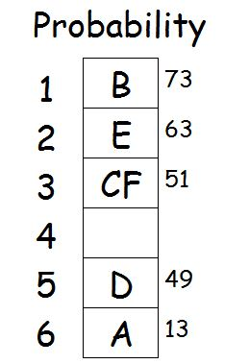
Global Climate Response Scenarios, 2040
A: Governments Get in Gear
B: Bottom-Up Progress
C: Private Sector Leads
D: Take it to the Streets
E: The Oblique Path to Progress
F: Welcome to the Anthropocene
CGA 2015 ranking

Slide 39
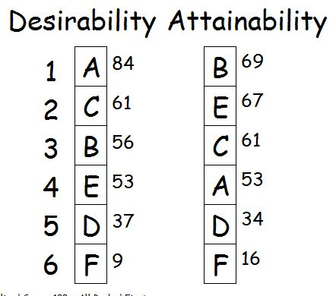
Our Regional Response Scenarios, 2040
A: Minimize our Carbon Footprint: model low carbon rural life
B: Community Resilience: harden infrastructure, strengthen communities
C: Hyper-Green Human Refuge: refugee in migration
D: Rise Up and Demand Change: calls for action
E: Pragmatic and Measured: don’t overreact, over invest
F: Regional Tipping Point: repeated extreme weather, depopulation
CGA 2015 ranking

Slide 40
Community 2
Philanthropy: Newcomb and Cranberry Lake received bequests in the millions via the Adk Foundation
Lots of smaller efforts: Winter46r, Leanto Rescue, ARISE in Tupper, four citizen science projects and ADK Gives
ADK and 46ers volunteers at trail heads

